Slide 1
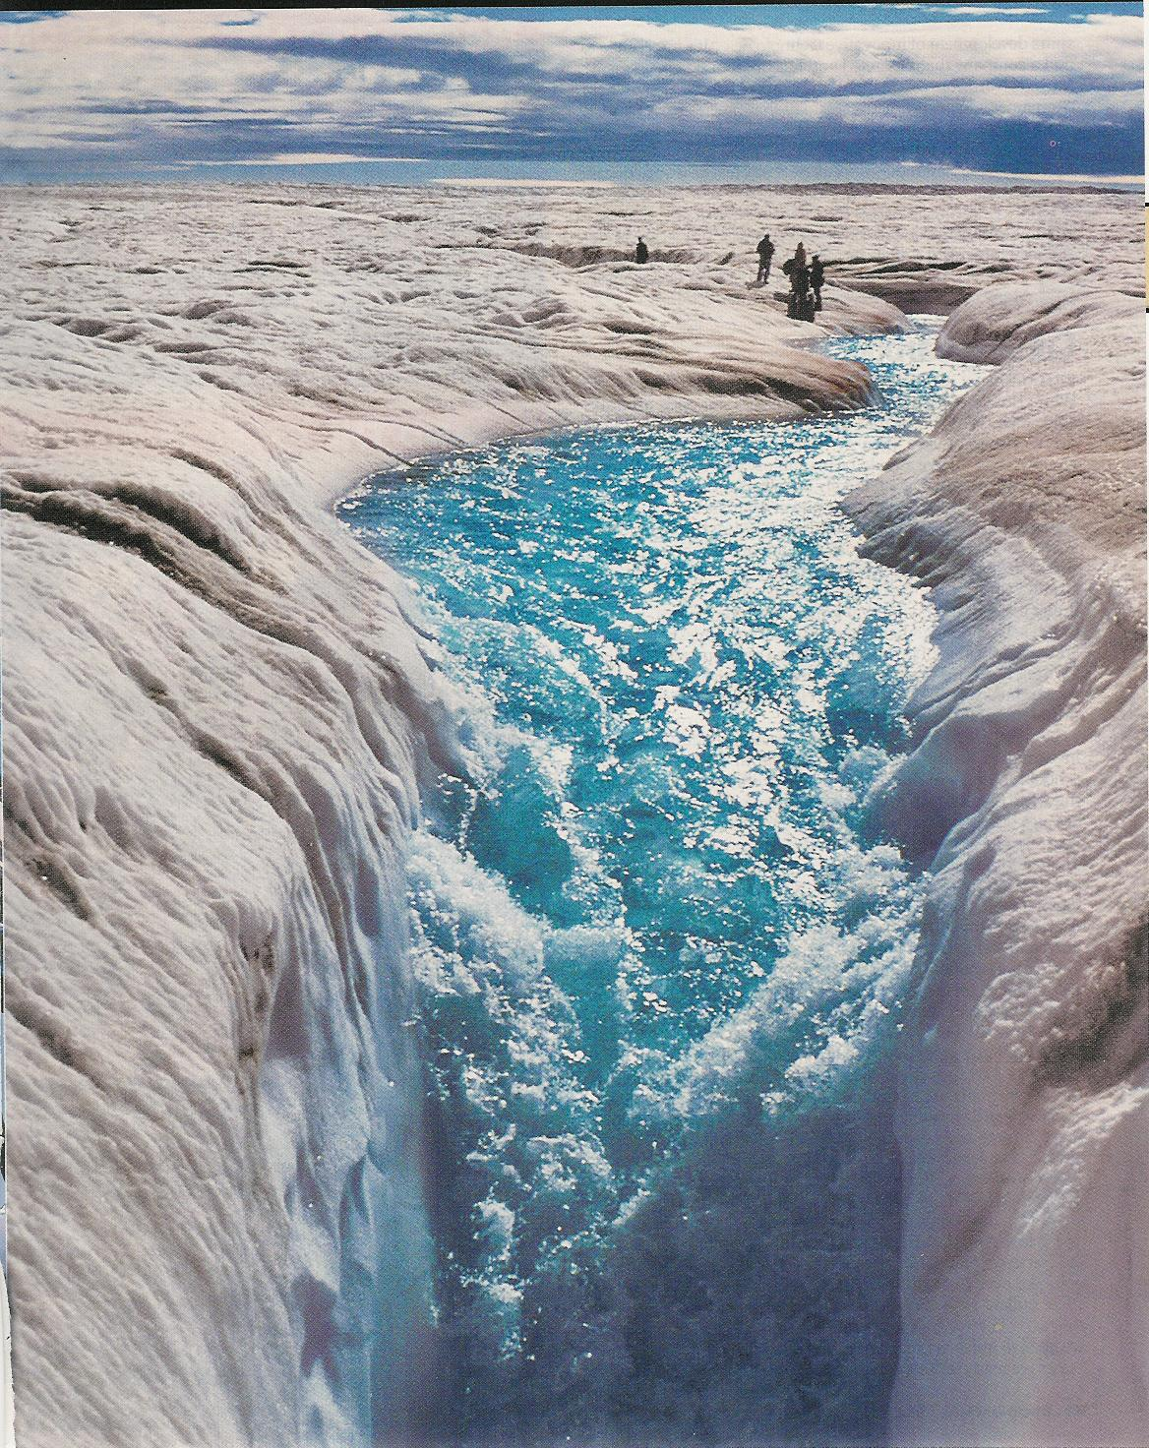
Streaming NetCDF
John Caron
July 2011

Slide 2
What does NetCDF do for you?
Data Storage: machine-, OS-, compiler-independent
Standard API (Application Programming Interface)
Multidimensional array data model
Efficient extraction of data subsets
Subset specified by array index ranges
Random access files
Predictable cost

Slide 3
NetCDF-3 file format
Header
Non-record
Variable
Variable 1
float var1(z, y, x)
Row-major order
Variable 2
Variable 3 …
Record
(unlimited) Variables
float rvar1(0, z, y, x)
Record 0
float rvar2(0, z, y, x)
float rvar3(0, z, y, x)
Record 1
float rvar1(1, z, y, x)
float rvar2(1, z, y, x)
float rvar3(1, z, y, x)
unlimited…

Slide 4
NetCDF-3 = Read-optimized
Very fast to read in header = “schema”
Disk layout is fixed
Simplest possible
Programmer decides on unlimited dimension
Easy for programmers to understand and predict I/O costs

Slide 5
NetCDF-4 file format
Built on HDF-5
Big Data
Much more complicated than netCDF-3
“Fractal heaps”
B-trees everywhere
Data stored in variable-length chunks
Each chunk can have multiple “filters”, e.g. compression

Slide 6
Multidimensional chunking

Slide 7
HDF5
Disk layout is not fixed
Knowing schema != knowing data layout
Programmer chooses chunking/compression, then trusts library
Like a File system, but not part of OS

Slide 8
OPeNDAP
Remote access to netCDF files
Index space
Similar data model
Different binary “format”
Opendap response is not a netCDF file

Slide 9
New Paradigm : “Web Services”
HTTP / URL
Standard Interfaces
Standard “payload” (HTML / XML)
OGC WxS (Web Map Service, Web Coverage Service, Web Feature Service)
Queries in Coordinate Space (Lat/Lon/Time)
netCDF is now an OGC standard payload

Slide 10
Returning a netCDF response
Can we write a netCDF file directly to the socket without first writing to disk?
netCDF-3: sometimes
Must know size of unlimited dimension beforehand
Can’t use standard libraries
NetCDF and application code gets mixed
netCDF-4 : not practical
Not impossible, but not worth pursuing

Slide 11
Queries are not in index space
You have a large collection of “features” spread out over many files
User makes a request for all features in a bounding box
You don’t know how many features satisfy the request
Server wants to query multiple files in parallel, write out results directly to socket

Slide 12
Design goals for a new netCDF file format
Allows direct writes to network == streaming
Append only
Concat multiple files -> valid file
Easily convert to/from netCDF-3 and netCDF-4
No loss of information in either direction
Read with Java or C netCDF libraries without conversion
“write optimized”

Slide 13
Implementation decisions for ncstream = “streaming netCDF”
ncstream = sequence of variable length messages
Full CDM/netCDF-4 data model
Binary encoding using Google's Protobuf
Binary object serialization, cross language, transport neutral, extensible
Very fast compared to XML
2-3x faster than TDS OPeNDAP
Post-processing creates indexes for efficiency

Slide 14
ncstream file format
message
message
message
…
message
…
message
message
message
message
message
message
…
message
…
message
message
message
index

Slide 15
CDM Remote Access Web Service
Subsetting in index space
Supports full CDM/netCDF-4 data model
Can be used instead of DAP 2.0 for queries in index space
Simple REST interface
Uses ncstream for encoding
Have experimental version in Java
CDM (NetCDF-Java library), ToolsUI client
TDS (THREDDS Data Server) cdmRemote service type
May enable in IDV soon
Have “pre-alpha” version in netCDF-C library

Slide 16
CDM Remote Feature Web Service
Subsetting in coordinate space
REST interface / ncstream for encoding
cdmrFeature service type in TDS
Follow on to Netcdf Subset Service
Point Feature datasets
Alpha version in TDS since version 4.2
Beta version in TDS 4.3 (Sep 2011)

Slide 17
Accessing Point Feature Collections
TDS
Java Client
CDM Point Feature API
cdmrFeature
Ncstream
cdmRemote
ncstream
CDM Point Feature API
Application
Coordinate Systems
Data Access
CDM Remote API
Data

Slide 19
Problem: how to get CDM functionality into netCDF C library?
Desired functionality
NcML, Aggregation
Access many other file formats (GRIB, BUFR, NEXRAD, etc)
Java has to run in its own process, cant be linked into C code
Reimplement CDM functionality in C library
200K+ LOC
OO, inheritence
OTOH, avoid blind alleys, use 3rd party libraries
Leave Java in its own process, communicate across processes

Slide 20
Possibility: CdmRemote Server
TDS variant
Lightweight server for CDM datasets
Zero configuration
Local filesystem
Allow one to cache expensive objects
Java and C clients
Allow non-Java applications access to CDM stack
Coordinate space queries
Virtual datasets
Feature Types

Slide 21
C library – enable other languages
TDS
Python / ?
C Client
CDM Point Feature API
cdmrFeature
Ncstream
cdmRemote
ncstream
CDM Point Feature API
Application
Coordinate Systems
Data Access
CDM Remote API
Data

Slide 22
TODO (lots)
Indexes
Compression
Convert to netCDF-4
CdmRemote server
Finalize protocol

Slide 23
Conclusions
ncstream = experimental netCDF file format
cdmremote = experimental remote access to CDM data
cdmrFeature = experimental “query in coordinate space” web service
Hope to have it kickable by end of year
More info: google cdmremote, ncstream

