Slide 1
NetCDF-Java Overview
John Caron
Oct 29, 2010

Slide 2
Contents
Data Models / Shared Dimensions
Coordinate Systems
Feature Types
NetCDF Markup Language (NcML)
THREDDS Data Server (TDS)

Slide 3
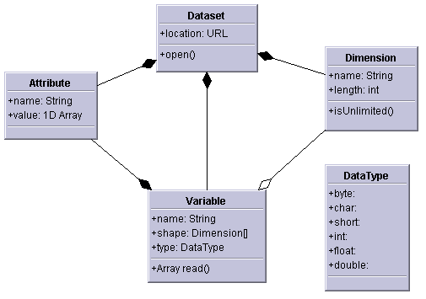
NetCDF-3 data model
Multidimensional arrays of primitive values
byte, char, short, int, float, double
Key/value attributes
Shared dimensions
Fortran77

Slide 4
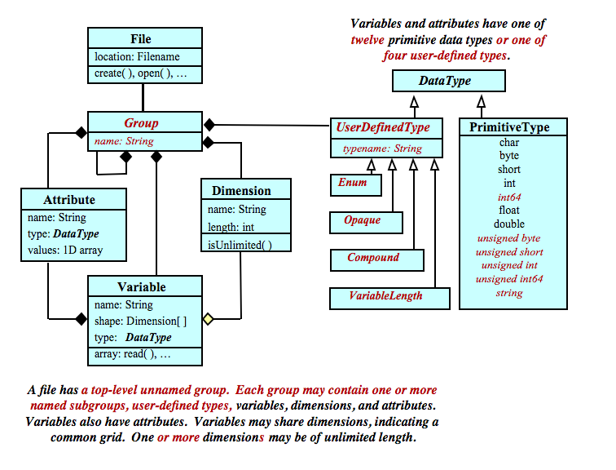
NetCDF-4 Data Model based on HDF5

Slide 5
NetCDF, HDF5, OPeNDAP Data Models
Shared
dimensions
NetCDF (classic)
NetCDF (classic)
OPeNDAP
NetCDF (extended)
HDF5

Slide 6
Gridded Data
Cartesian coordinates
Data is 2,3,4D
All dimensions have 1D coordinate variables
float gridData(t,z,y,x);
float t(t);
float y(y);
float x(x);
float z(z);
netCDF: coordinate variables
OPeNDAP: approx grid map variables
HDF: dimension scales

Slide 7
Point Observation Data
Set of measurements at the same point in space and time = obs
Collection of obs = dataset
Sample dimension not connected
float obs1(sample);
float obs2(sample);
float lat(sample);
float lon(sample);
float z(sample);
float time(sample);
netCDF-CF: auxiliary coordinate variables
OPeNDAP: grid map variables (?)
HDF: dimension -> dimension scales must be 1-N

Slide 8
Swath
two dimensional
track and cross-track
not separate time dimension
aka curvilinear coordinates
float swathData( track, xtrack)
float lat(track, xtrack)
float lon(track, xtrack)
float alt(track, xtrack)
float time(track)
netCDF-CF: auxiliary coordinate variables
OPeNDAP: not in DAP-2
HDF: no

Slide 9
Shared Dimensions Summary
netCDF
Shared dimension plus conventions is general solution for coordinates
:coordinates = “lat lon alt time”
OPeNDAP
No shared dimensions in current data model
Shared dimensions will be added to DAP-4 (still waiting)
:coordinates = “lat lon alt time”
HDF5
No shared dimensions in current data model
HDF-EOS added shared dimensions in metadata (NPOESS took them out)
NetCDF-4 adds a workaround
NetCDF-4 not a subset of HDF-5
NetCDF-4 does not read all HDF-5 objects
HDF-5 not a subset of NetCDF-4

Slide 10
Editorial
We’ve “solved” the syntactic issues
Hardware, OS, application independence
Encapsulate file storage details
Efficient strided array access
TODO: parallel I/O, very large files, adapting to new hardware (SSD, etc)
The next 5 years are about adding “semantic” support
Unidata : Earth Science domain
Georeferencing (space / time subsetting)
Virtual datasets: Encapsulate file collection details

Slide 11
Unidata’s Common Data Model
Scientific Feature Types
Point
Trajectory
Station
Profile
Objects,
How the User
sees the data
Radial
Grid
Swath
Coordinate Systems
Georeferencing,
topology
Data Access
netCDF-3, HDF5, OPeNDAP
BUFR, GRIB1, GRIB2, NEXRAD, NIDS, McIDAS, GEMPAK, GINI, DMSP, HDF4, HDF-EOS, DORADE, GTOPO, ASCII
Storage format,
multidimensional arrays

Slide 12
C
count[0] = 1;
count[1] = NLVL;
count[2] = NLAT;
count[3] = NLON;
start[1] = 0;
start[2] = 0;
start[3] = 0;
/* Read and check one record at a time. */
for (rec = 0; rec < NREC; rec++) {
start[0] = rec;
nc_get_vara_float(ncid, pres_varid, start,
count, &pres_in[0][0][0])));
// process data
}

Slide 13
Java
int[] origin = new int[4];
int[] shape= precVar.getShape();
shape[0] = 1; // only one rec per read
// loop over the rec dimension
for (int rec = 0; rec < shape[0]; rec++) {
origin[0] = rec; // read this index
Array presArray = presVar.read(origin, shape);
// process data
}

Slide 14
“Index Space” Data Access
OPeNDAP
http://motherlode.ucar.edu:8080/thredds/dodsC/
NAM_CONUS_80km_20081028_1200.grib1.dods?
Precipitable_water[5][5:1:30][0:2:77]
Netcdf-Java
NetcdfFile ncfile = NetcdfFile.open(“NAM_CONUS_80km_20081028_1200.grib1”);
Variable v = ncfile.findVariable(“Precipitable_water”);
Array data = v.read(“(5)(5:30)(0:77:2)”);

Slide 15
“Coordinate Space” Access
float gridData(t,lev,lat,lon);
float t(t); // coordinate variables
float lev(lev); // must be monotonic
float lat(lat);
float lon(lon);
float[] level = new float[]{23.6, 78.0};
float[] lat = new float[]{40.0, 42.0};
float[] lon = new float[]{-103.6, -78.0};
for (float time : timeCoords) {
Array data=gridData.read(time,level,lat,lon);
// process
}

Slide 16
“Georeferenced” access
Netcdf Subset Service:
http://motherlode.ucar.edu:8080/thredds/ncss/grid/
NAM_CONUS_80km_20081028_1200.grib2?
var=Precipitable_water&
time=2008-10-28T12:00:00Z&
north=40&south=22&west=-110&east=-80
WMS:
http://motherlode.ucar.edu:8080/thredds/wms/
NAM_CONUS_80km_20081028_1200.grib2?
SERVICE=WMS&VERSION=1.3.0&REQUEST=GetMap&
CRS=EPSG:4326&WIDTH=800&HEIGHT=400&FORMAT=image/png&
STYLES=boxfill/redblue&COLORSCALERANGE=-10,10&
LAYERS=Precipitable_water&
BBOX=-40,22,-110,-80&
TIME=2008-10-28T12:00:00Z

Slide 17
TimeSeries “Feature Type”
LatLonRect bb=new LatLonRect(new LatLonPointImpl(40.0, -105.0),
new LatLonPointImpl(42.0, -100.0));
Date start= DateFormatter.getISODate(“2010-10-12T00:00:00”);
Date end = DateFormatter.getISODate(“2010-10-22T12:00:00”);
DateRange dr = new DateRange(start, end);
PointFeatureCollection points = stationTimeSeriesCollection.subset(bb, range);
while( points.hasNext() ) {
PointFeature pointFeature = points.next();
...
}

Slide 18
Grid “Feature Type”
LatLonRect bb = new LatLonRect(new LatLonPointImpl(40.0, -105.0),
new LatLonPointImpl(42.0, -100.0));
Date start= DateFormatter.getISODate(“2010-10-12T00:00:00”);
Date end = DateFormatter.getISODate(“2010-10-22T12:00:00”);
DateRange dr = new DateRange(start, end);
Array data = grid.subset(bb, dateRange);
while(data.hasNext() ) {
double d = data.next();
...
}

Slide 19
Scientific Feature Types
Application
Datatype Adapter
NcML
NetcdfDataset
NetCDF-Java/
CDM architecture
CoordSystem Builder
Georeferencing Access
NetcdfFile
I/O service provider
OPeNDAP
NetCDF-3
NIDS
NcML
NetCDF-4
GRIB
HDF4
GINI
Nexrad
Index Space Access
DMSP
…
Notes:
19

Slide 20
Coordinate System UML

Slide 21
Netcdf-Java Library parses these Conventions
CF Conventions (preferred)
COARDS, NCAR-CSM, ATD-Radar, Zebra, GEIF, IRIDL, NUWG, AWIPS, WRF, M3IO, IFPS, ADAS/ARPS, MADIS, Epic, RAF-Nimbus, NSSL National Reflectivity Mosaic, FslWindProfiler, Modis Satellite, Avhrr Satellite, Cosmic, ….
Write your own CoordSysBuilder Java class

Slide 22
Projections (CF)
albers_conical_equal_area
lambert_azimuthal_equal_area
lambert_conformal_conic
mcidas_area
mercator
orthographic
rotated_pole
stereographic (including polar)
transverse_mercator
UTM (ellipsoidal)
vertical_perspective

Slide 23
Vertical Transforms (CF)
atmosphere_sigma
atmosphere_hybrid_sigma_pressure
atmosphere_hybrid_height
ocean_s
ocean_sigma
existing3DField

Slide 24
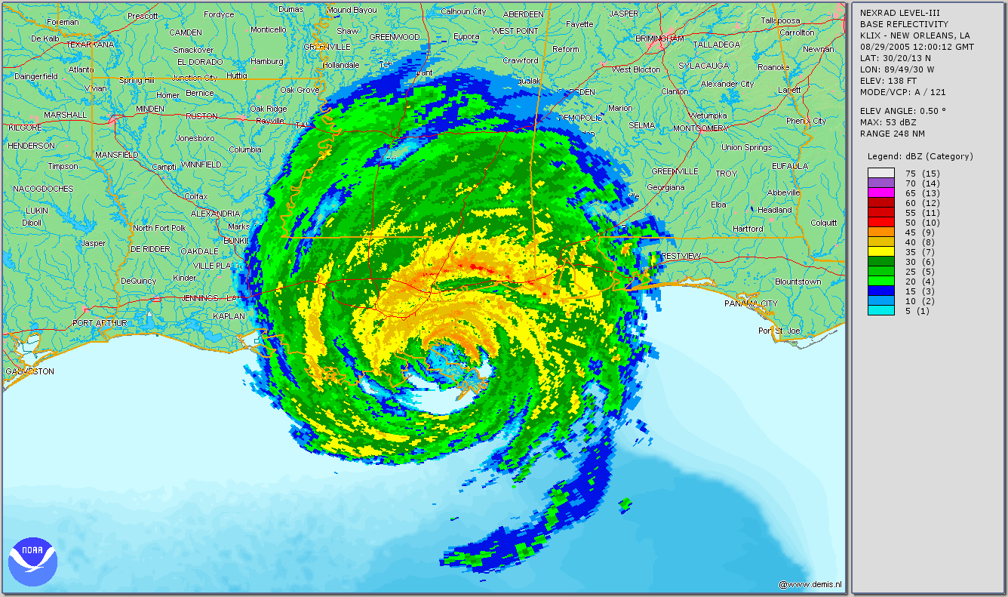
NOAA's Weather and Climate Toolkit

Slide 25
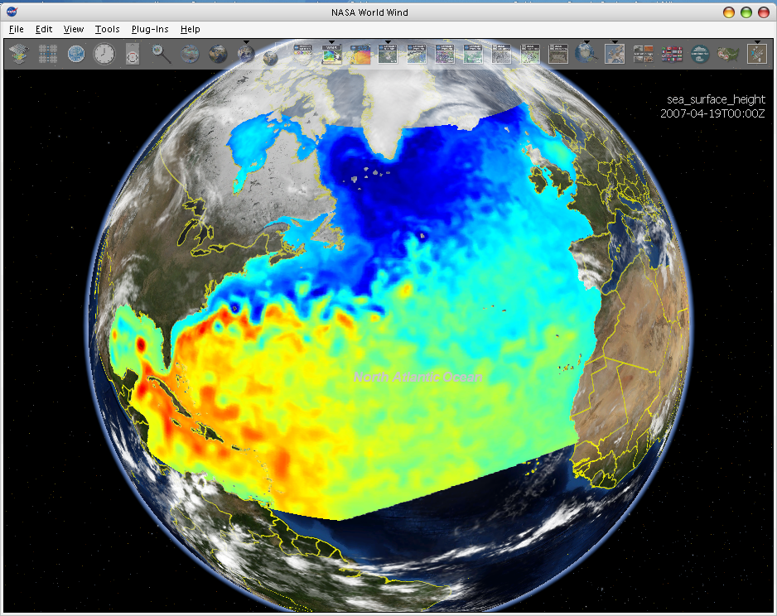
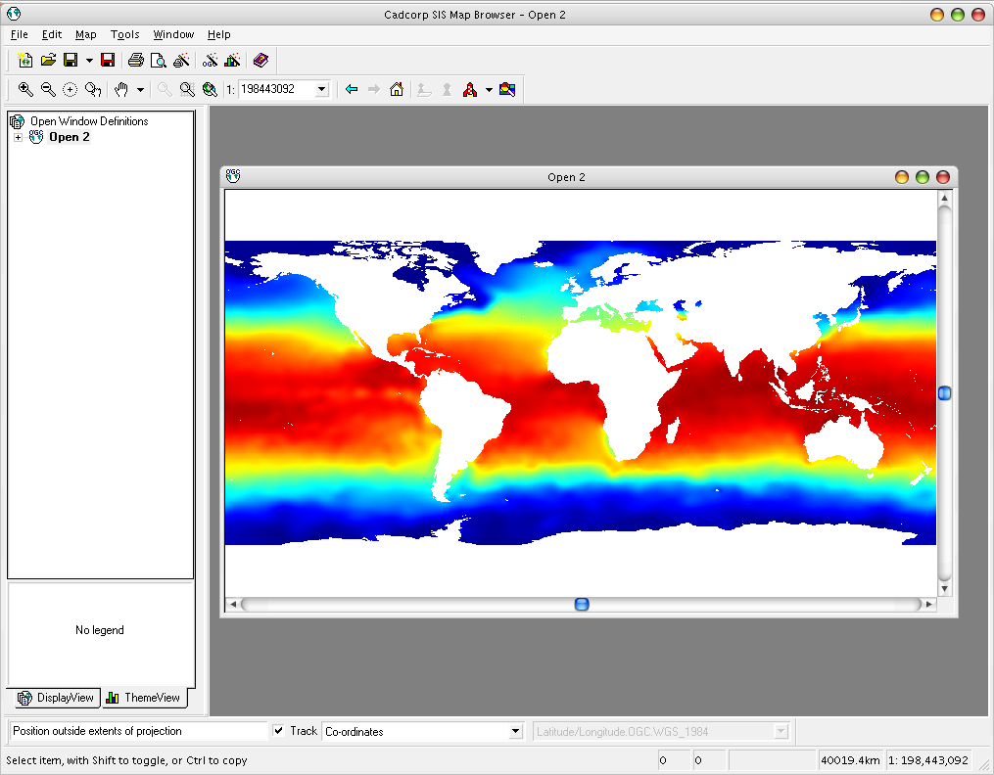
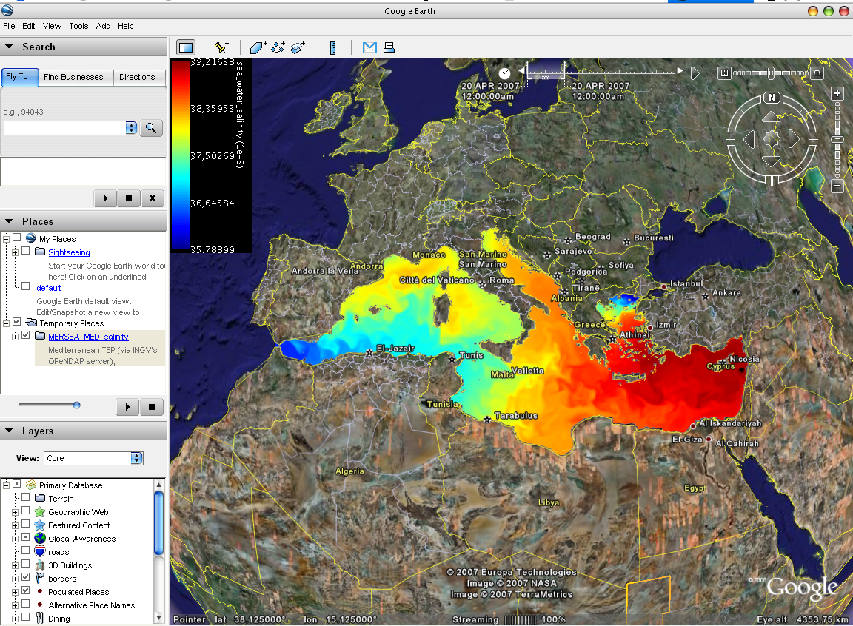
WMS Clients
NASA World Wind
Cadcorp SIS
Google Earth
3rd-party clients can’t use the custom WMS extensions

Slide 26
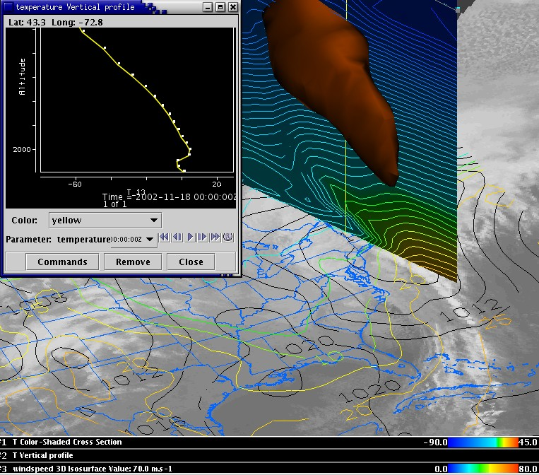
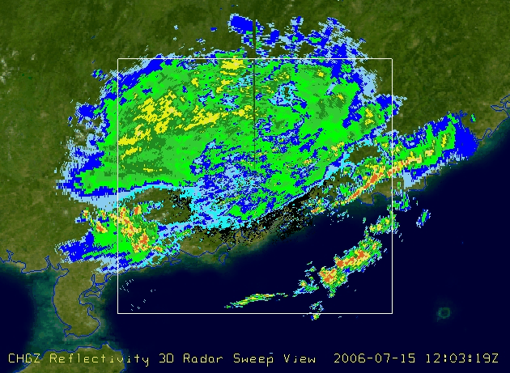
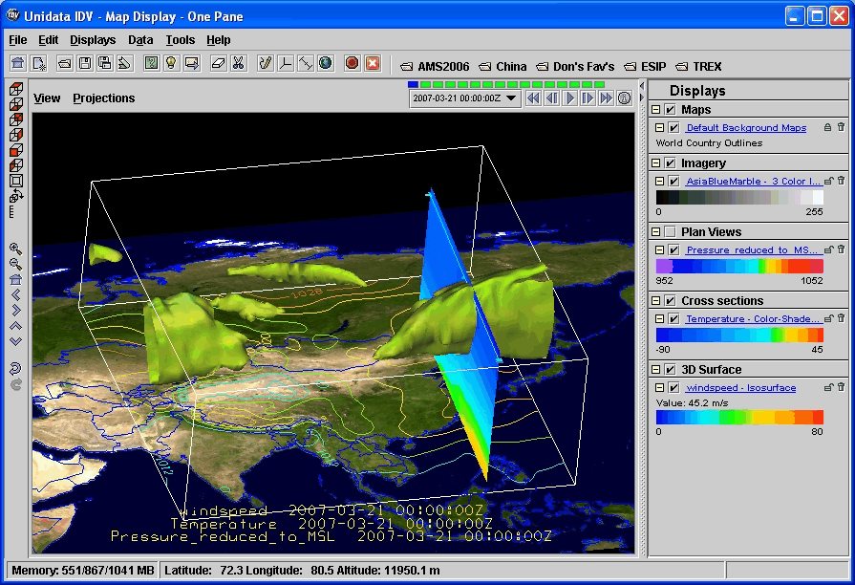
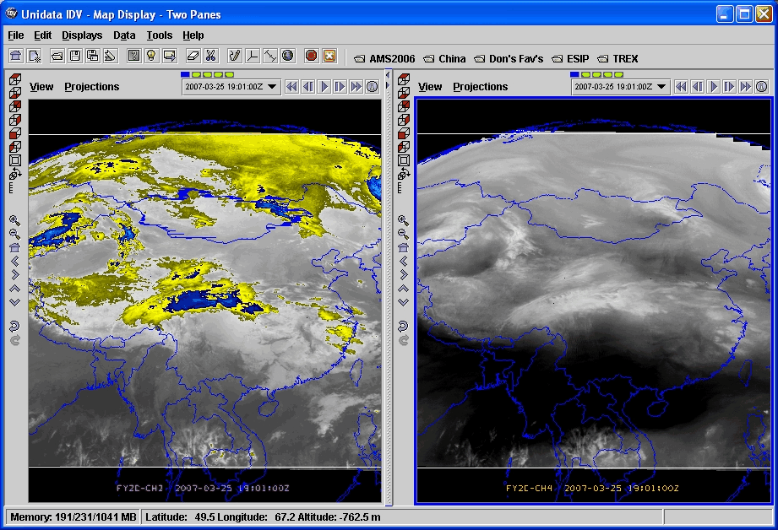
Unidata’s Integrated Data Viewer

Slide 27
THREDDS Data Server
Servlet Container
catalog.xml
Remote Access
Client
THREDDS Server
WCS
OPeNDAP
HTTPServer
WMS
NetCDF-Java
library
configCatalog.xml
Datasets
IDD Data
motherlode.ucar.edu

Slide 28
THREDDS Data Server (TDS)
Web server for scientific data
Provides remote data access
HTTP file transfer
OPeNDAP (index space subsetting)
Open Geospatial Consortium (OGC) WMS and WCS (coordinate space subsetting)
Experimental data access protocols
NetCDF Subset Service
CdmRemote

Slide 29
OGC Web Map Service
WMS 1.3
Jon Blower’s (Reading, UK) ncWMS integrated with TDS
Coordinate Space subsetting
Produces JPEG output
Fast generation of images
Reproject images into large number of coordinate systems (uses GeoToolkit)

Slide 30
OGC Web Coverage Service
WCS 1.0
Coordinate Space subsetting
Returns data, not pictures
GeoTIFF floating point, grayscale
NetCDF-CF
No reprojections, resamplings
Restricted to CDM files that have Grid coordinate system
evenly spaced x,y

Slide 31
NetCDF Markup Language (NcML)
Modify (“fix”) existing datasets without rewriting them
Often its possible to add missing coordinate information that allows georeferencing by standard tools
Notes:
Another component of the netCDF java library is support for the netCDF Markup Language. NcML is an XML representation of netCDF metadata. It can be used to create new netCDF files as well as modify an existing dataset and even aggregate a set of existing datasets.

Slide 32
NetCDF-Java Summary
NetCDF-Java Library is widely used, because:
Handles multiple file formats, single API
Grungy details of Coordinate System encodings
So many standards to choose from!
NcML allows dataset modification without rewrite
NcML aggregation for virtual datasets
Remote access is built in

Slide 33
Issues
HDF5 != netCDF-4
Should it?
OPeNDAP hasn’t delivered DAP4
Can’t transport NetCDF-4 extendd data model
Build libraries on top of data access libraries
Coordinate systems: standardize?
Feature Types : Grids, Swaths, Radial, Discrete Sampling, Unstructured Grids, Polylines

Slide 34
How to get this functionality into netCDF C library?
Java has to run in its own process, cant be linked into C
Reimplement CDM functionality in C library
200K+ LOC
OO, inheritence
OTOH, avoid blind alleys, 3rd party libraries
Leave Java in its own process, communicate across processes

Slide 35
CdmRemote Server
CdmRemote
Local
Client
socket
Cdmremote
protocol
Local
Client
NetCDF-Java
Library
Scientific Features
Coordinate Systems
Data Access
Local File
System

Slide 36
Possibility: CdmRemote
Lightweight server for CDM datasets
Zero configuration
Local filesystem
Cache expensive objects
Uses ncstream for on-the-wire protocol, probably over HTTP
Java and C clients
Allow non-Java applications access to CDM stack
Coordinate space queries
Virtual datasets
Feature Types

Slide 37
Possibility: ncstream
Write-optimized encoding of CDM datasets
append only
Streaming data across network
Binary encoding using Google's Protobuf
Efficient, extensible
Ncstream <--> NetCDF4

Slide 38
Summary
We should build higher level abstractions on top of existing data access libraries
Standardize semantic conventions for coordinate systems, discovery metadata, etc.
Deal with very large collections of scientific data files
Keep pushing common tasks into libraries, let scientists do science

Slide 39
Thank You

