Slide 1
Unidata Policy Committee
23-24 May 2011
Organizational Collaboration, Participation, and Support - Linda Miller
Promoting Diversity – Linda Miller
Serving Data to other Communities via Standard Interfaces - Ben Domenico

Slide 2
Broadening participation and expanding community service
Priorities set forth in the 2008-2013 NSF proposal
Continue to foster a shared vision for and community ownership of the program, creating a framework for capturing community input (Slide 4)
Provide a transformative learning environment for the community by involving users as both contributors to and stakeholders in Unidata (Slide 5)
Broaden participation in Unidata from closely-related geoscience disciplines such as hydrology and oceanography
Adapt services to the needs of the climate community
Leverage partnerships with universities to entrain nearby community colleges into the Unidata community

Slide 3
Priorities set forth in the 2008-2013 NSF Proposal – cont.
Continue to broaden participation in Unidata governing committees
Bring the community and stakeholders together to share knowledge and address problems through meetings, workshops, conferences, and other venues
Develop global partnerships with geoscience data holders for free and open sharing of data
Advocate for community interests in areas pertaining to data needs, policies regarding data access and use, and related technological matters (Slide 7)
Bridge communities across a range of computing resources and capabilities; e.g., connect Unidata systems and services with NSF HPC resources like the TeraGrid
Manage and expand the community equipment awards program to serve the evolving needs of the community (Slide8)

Slide 4
Organizational Collaboration, Participation, and Support
“Continue to foster a shared vision for and community ownership of the program, creating a framework for capturing community input”
Governing Committees play an important role:
  Recommendations for new data set availability, i.e., global lightning, CONDUIT, NOAAPORT, Satellite data (Wisconsin, NESDIS)
  Diversity of representatives on the committees and small/large institutional representation
  Users community survey – 2010
  Users Committee triennial workshop – 2009; planning underway for 2012
Training workshops (Slide 2)
 | Total Attendees | Number of Universities Represented | Number of International Sites | Number of Government, Military or Institute (non profits) | Private Industry
2008 | 77 | 20 | 8 | 48 | 6
2009 | 95 | 39 | 6 | 47 (16 from UCAR) | 6
2010 | 77 | 12 | 7 | 45 (9 from UCAR) | 15

Slide 5
Provide a transformative learning environment for the community by involving users as both contributors to and stakeholders in Unidata
Many examples
  E-letter and web page news items and community articles, now News@Unidata blog
  Encouragement of community interaction via Facebook & Twitter postings
  Seminars (13 since Apr 2008)
  Contributions and collaborations on software updates and changes (IDV, netCDF, THREDDS, RAMADDA, etc)
  Extensive use of email lists
  DeSouza Award (3 awards since 2008)
  (Slide 2)

Slide 6
Broaden participation in Unidata from closely-related geoscience disciplines such as hydrology and oceanography
Diversity on governing committees
  Hydrology
  Oceanograpy
  Geography
  Mix of researchers and educators
  Student representative to Users Committee
Participation in meetings; AMS, AGU, EGU, NOAA Partners, OGC (Ben will discuss this) and many others
International participants have increased
  (127 countries have downloaded software-4/1/10-3/31/11)
For all downloads stats, see: http://www.unidata.ucar.edu/committees/usercom/2011Apr/status/metrics/downloads.html

Slide 7
Advocate for community interests in areas pertaining to data needs, policies regarding data access and use, and related technological matters
Work with data providers and Users Committee to access important data sets used for education and research purposes
  CONDUIT now being served by Penn State
  Entire NDFD datastream available in CONDUIT
  RTMA -- Real Time Mesoscale Analysis in CONDUIT
  SREF -- Short Range Ensemble Forecast members added to CONDUIT
Two reps from NCEP added to Users Committee (Rebecca Cosgrove (CONDUIT); Michelle Mainelli (NAWIPS to AWIPS II transition)
Monitoring GOES-R, NPOESS, Dual-Pol, NexGen, 4-D Cube, etc.
COSMIC data made available via LDM (2008)
NAWIPS to AWIPS II transition – actively engaged! (collaboration with NWS and NCEP began 2008)
(Slide 4)

Slide 8
Manage and expand the community equipment awards program to serve the evolving needs of the community
Equipment Awards – managed by Terry with assistance from Ginger (Slide 3)
2008 | 2009 | 2010 | 2011
3 | 6 | 8 | 8

Slide 9
Promoting Diversity
Unidata is actively engaged in the following:
Significant Opportunities in Atmospheric Research and Science
American Indian Higher Education Consortium
Alaska Tribal Colleges
UCAR African Initiative
Undergraduate Leadership Workshop
Governing committees

Slide 10
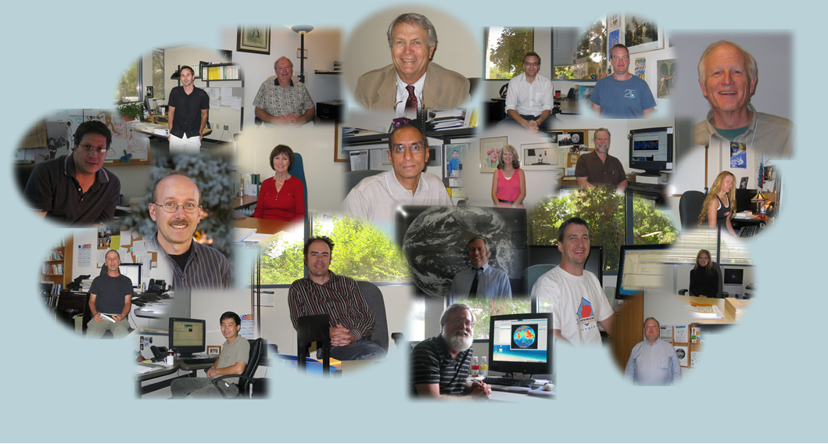
Community Driven Unidata Staff!

