Slide 1
Director’s Report
Unidata Policy Committee
23 May 2011
North Carolina State University
Raleigh, NC
Mohan Ramamurthy
Unidata Program Center
UCAR Community Programs
Boulder, CO

Slide 2
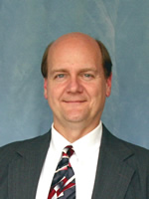
Polcomm Welcome
  Dr. Kevin Kloesel, University of Oklahoma
    Director, Oklahoma Climate Survey
    Associate Dean, College of Atmospheric and Geographic Science
    Professor, School of Meteorology
  Welcome!

Slide 3
Change in Users Committee
Membership
  Francina Dominguez, University of Arizona
  Brian Etherton – He has started a new position with NOAA/ESRL/GSD in March 2011.
We thank both of them for their service.
We will especially miss Brian for his insights and thoughtful comments, and active engagement over the past three years.
Please be thinking of new members to fill these and two additional vacancies we will have as Brendon Hoch and Larry Oolman rotate-off from the Users committee.

Slide 4
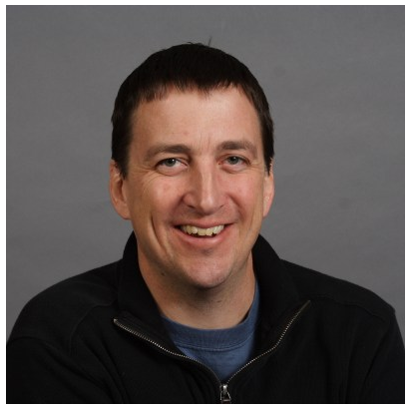
Technical Project Manager
In December 2010, Ethan Davis was appointed as Technical Project Manager.
He is supervising all of the software engineering staff within the UPC and facilitating coordination between projects.
The TPM position is a 0.5 FTE appointment. Ethan continues to spend the remaining time in the THREDDS project.

Slide 5
Staffing Changes
Brian Kelly left Unidata in April 2011. His departure has been in the works for nearly a year.
  A search is underway for a replacement.
The UPC has hired two new software engineers.
  Sean Arms, University of Oklahoma (SE II); He brings domain expertise and begins work today. He will be defending his dissertation soon.
  Aaron Rogan, SE III, has a Ph. D. in Computer Science. He will start on 13 June.
They will be assigned initially to work on the IDV, TDS, and general support.

Slide 6
Current Allocation of Effort by Technical Staff

Slide 7
Anticipated Allocation of Effort

Slide 8
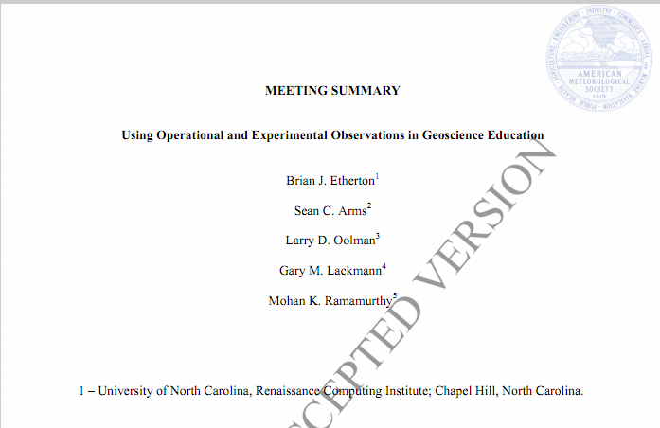
The 2009 Unidata Triennial Users Workshop Publication
Will appear in the April issue of BAMS.
CONGRATULATIONS TO ALL! And a special thank you to Brian for leading the effort!!

Slide 9
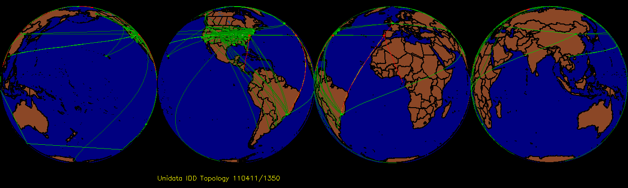
Real-time Data Flows
About 500 machines at 250+ sites are running LDM-6 and reporting real time statistics. These numbers have not changed much in the past 2+ years, but the data volume has grown significantly. Many more organizations are using the LDM but not reporting real-time stats to Unidata.
UPC’s IDD Cluster relays data to more than 650 downstream connections. Average data output/day: 5.7 TB or 525 Mbps! Peak rate exceeds 1.1 Gbps.
Data input to the cluster remains at ~7 GB/hour.
CONDUIT and WSR 88-D Level II remain the top two data streams based on volume. NEXRAD volume will increase with the availability of Dual-pol radar data.

Slide 10
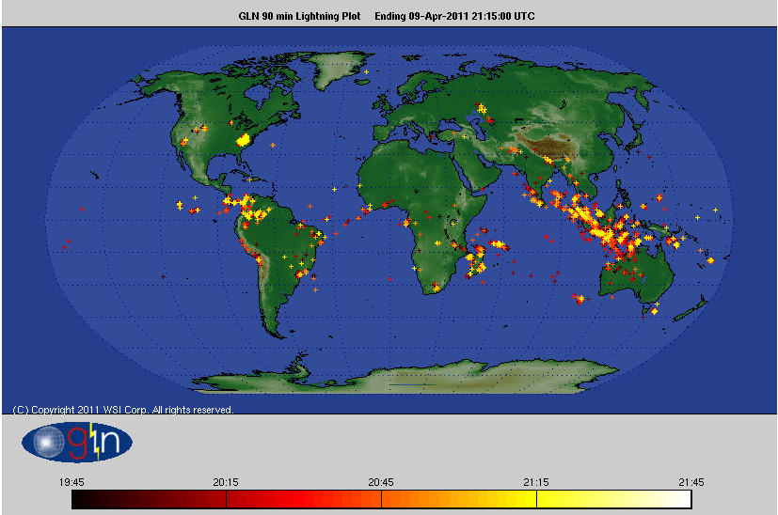
Global Lightning Data
Now Available to the Unidata Community, courtesy of WSI Inc.
Sensors are located at more than 150 international sites, in addition to the detectors that make up the NAPLN.
Data are collected in a 1-minute bin, and contain cloud-to-ground stroke data and some cloud flash discharges.

Slide 11
Next Generation LDM
The project has been put in the back burner for now, based on the recommendation by the Unidata Technical Review Panel.
Going forward, Steve Emmerson, the primary developer for LDM, UDUNITS, & ngLDM, will devote some of his time to AWIPS II porting and testing when the UPC receives AWIPS II source code from NWS.

Slide 12
NetCDF
NetCDF version 4.1.2 of the C-based software was announced on March 29, 2011. Important changes in this release were:
  changes for building cleanly on Windows;
  building shared libraries by default, instead of static libraries;
  greatly speeding up opening of large or complex netCDF-4 files;
  adding security authorization to the C OPeNDAP client for Earth System Grid use and for standard HTTP authorization using passwords;
  adding compression and chunking capabilities to the nccopy utility
  Includes a number of bug fixes as well as improvements in portability, extensibility, maintainability, and other new features.

Slide 13
OGC Adoption of NetCDF as a standard
OGC Technical Committee and Planning Committee have formally adopted netCDF as an international standard for data encoding. Ben deserves much credit for shepherding this process!!!
This is a major milestone and an important step to facilitate data sharing and integration among geosciences disciplines and societal impacts and hazards communities.
NetCDF joins other encoding standards such as ISO Geography Markup Language (GML) and Google's KML, but netCDF is the first adopted binary encoding format.
Among many others, GIS leader ESRI has incorporated netCDF read/write access into their products.
Notes:
-- OGC (Open Geospatial Consortium, a non-profit, international, voluntary consensus standards organization that is leading the development of standards for geospatial and location based services)
-- Working closely with NCAR (especially the GIS Program), Unidata serves as UCAR/NCAR representative to the OGC
-- Many countries (especially European Community) legally require data systems to adhere to OGC and ISO standards

Slide 14
THREDDS
TDS is currently at version 4.2.5
  Distribution now includes the ncISO metadata services
  Added OPeNDAP handling of ESG access control (other access control improvements)
  Subsetting services for Point Obs data extended to Station data
Common Data Model software is at 4.2.23:
  The Discrete Observations Convention is now complete, should be added to CF-1.6.
  NEXRAD2: Dual-pol radar data
  GrADS Binary Grid Service Provider (Don Murray)
  NetCDF-Java can now be built with Maven. It will be added to the standard Maven repository.

Slide 15
RAMADDA
RAMADDA project has migrated to SourceForge.
Involving broader participation by the open source developer community will ensure the continued success of RAMADDA.
Jeff McWhirter, the primary developer of RAMADDA, is continuing to actively develop RAMADDA.
Unidata will continue to participate in the RAMADDA project by supporting its user community and contributing to the open source development effort.
Unidata demonstrated RAMADDA and the IDV plug-in to attendees who visited our booth at the AMS Annual Meeting.
Tom Yoksas demonstrated RAMADDA and IDV during an interactive lab session that was held last week at the University of Vienna last week.

Slide 16
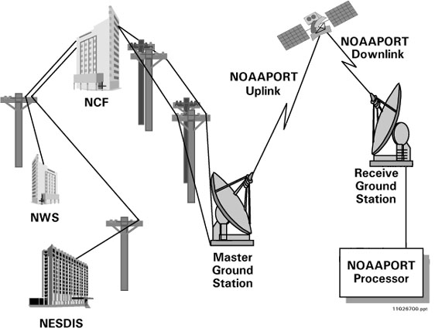
NOAAPort Ingest Software
Unidata has also developed NOAAPort SBN ingest software.
It is known to be used by at least 17 sites.
Seven sites are serving as ingest point for NOAAPORT data.

Slide 17
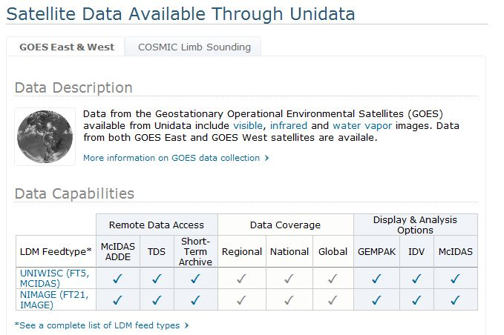
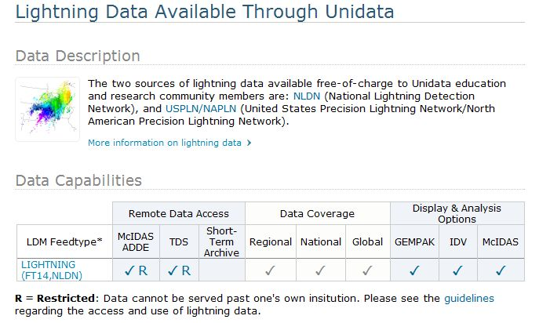
Data Availability Tables

Slide 18
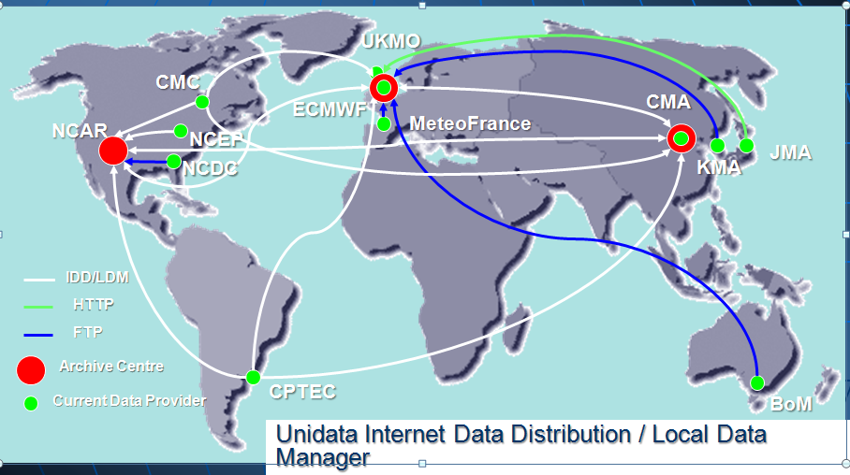
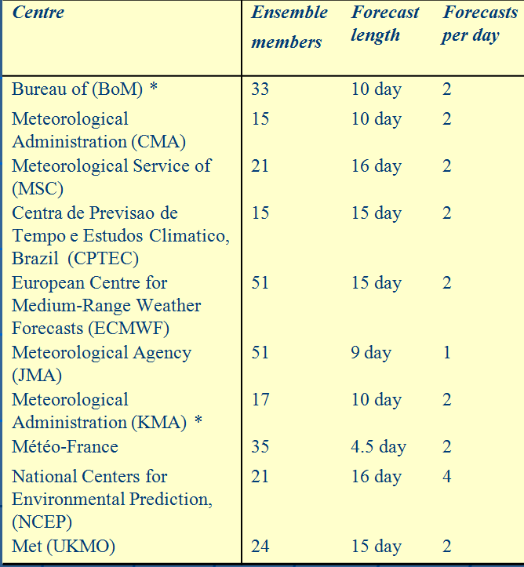
THORPEX Interactive Grand Global Ensemble (TIGGE) Project
The TIGGE database now has ~0.5 Pb of data and it is growing at a rate of 500 Gb/day.
Users processed about 37 Tb and downloaded ~2.8 Tb of data in December 2010.
The 48-hour embargo continues.

Slide 19
Integrated Data Viewer
Three updates to IDV version 2.9 have been since May 2010. Recent advances include:
  Support for CDM trajectory data
  Support for Dual-pol WSR-88D radar data
  Support for NLDN and USPLN lightning data
  Additional GEMPAK diagnostic functions (PVOR, RELH, ...)
Ongoing development
  Support for GEMPAK surface and upper air data
  Support for GRADS data
  Hovmoller diagram
  Ensemble user interface and functions: average, max/min, mode, percentile, range, and standard deviation
  Contour labeling: font, size, and alignment

Slide 20
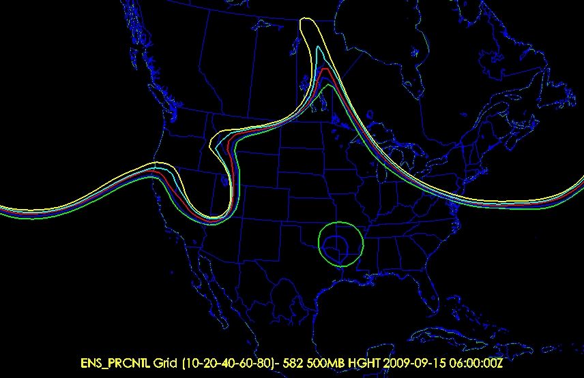
IDV: Ensemble Visualization
Hot off the press!
Ensemble user interface: selecting, subsetting, color by member
Ensemble functions: average, max/min, mode, percentile, range, and standard deviation

Slide 21
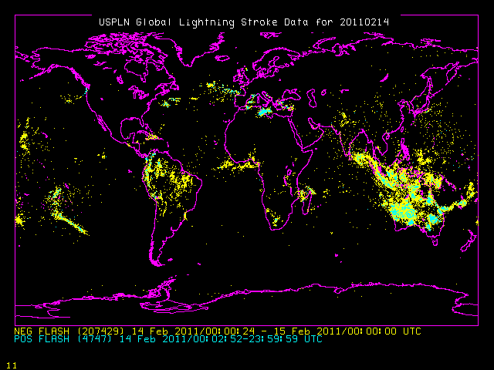
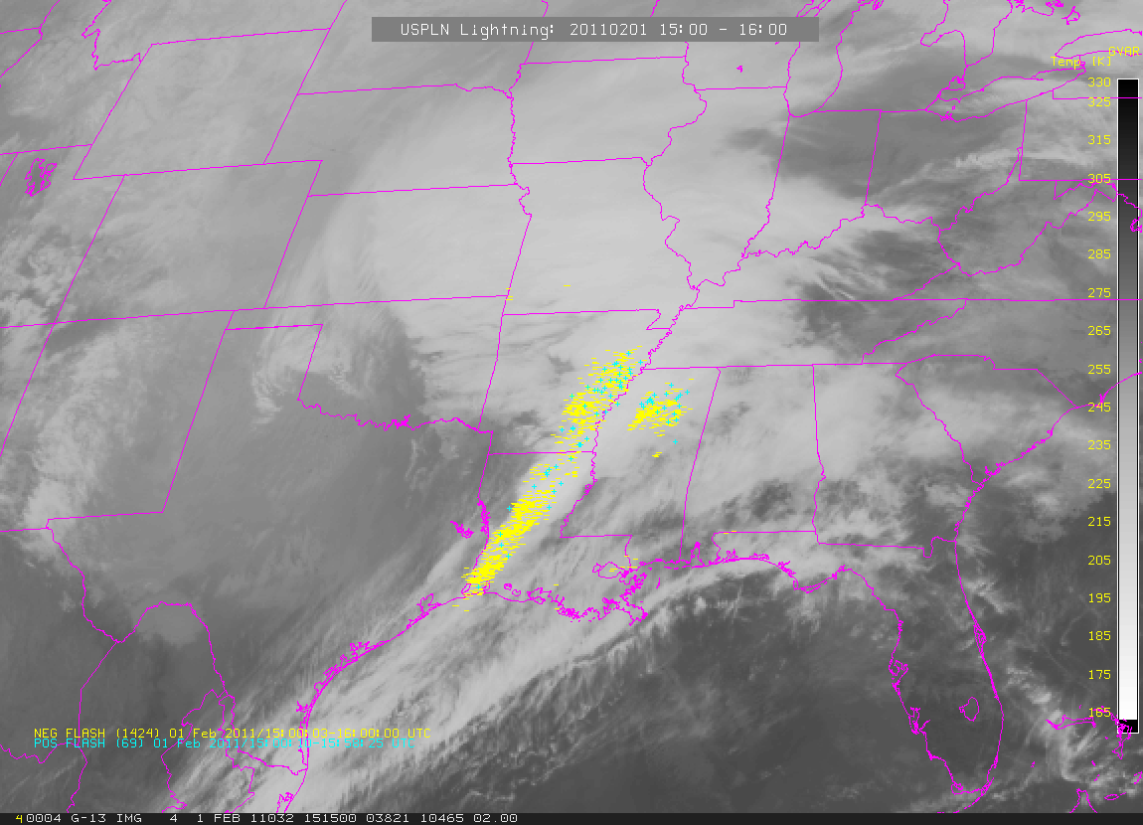
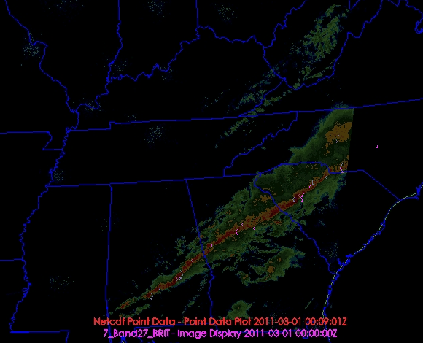
Lightning Data Visualization
McIDAS-X
IDV

Slide 22
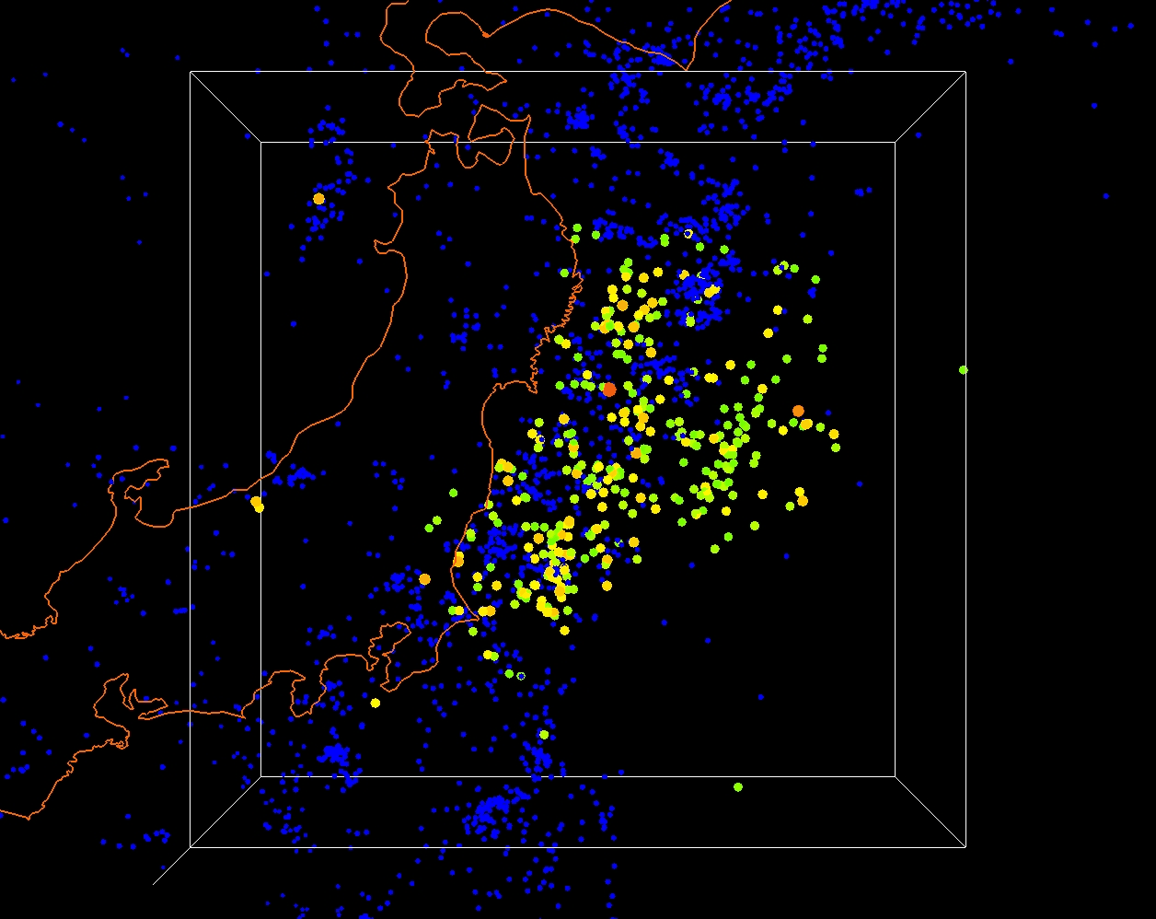
Japan Earthquake
Visualization using the IDV

Slide 23
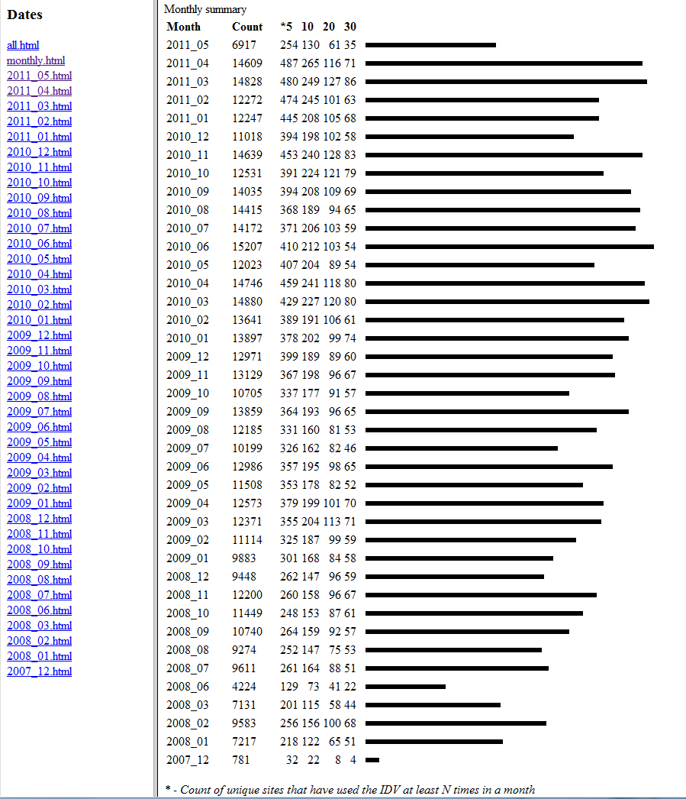
IDV Downloads and Usage
There is continued growth in the number of IDV downloads and its daily usage.
It was used by ~490 sites per day in April 2011

Slide 24
GEMPAK
GEMPAK use has remained steady since the last User Committee meeting in October 2010.
GEMPAK 6.2.0 released November, 2010. Additions include
  support for GEMPAK applications to access the AWIPS2 database,
  improved support for NEXRAD high-resolution level 3 products,
  improvements to nex2gini, additional GOES satellite product handling, updated external libraries (netCDF, HDF5, PNG, zlib, etc.) and various other bug fixes.
Ongoing/Planned Activities
  End of Unidata support for GARP and separation of GARP from default build / installation for GEMPAK 6.3.0
  Future GEMPAK training sessions will also include AWIPS-II configuration and use.

Slide 25
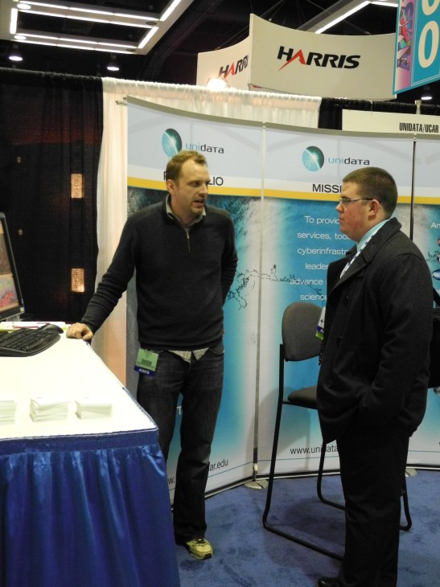
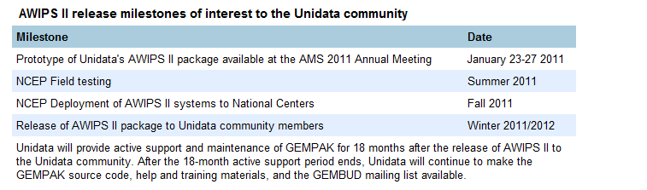
AWIPS II Update
Receiving regular releases from NCEP.
Recent advances:
  Improved data ingest / decoding using the LDM: grid, mcidas satellite images, text (uair, lightning, watch/warn)
  Simplified installation w/ RPM packages
  Added NSHARP functionality
Issues:
  Availability of 64-bit software
  Lengthy start-up time and sluggish performance
Notes:
Unidata's Michael James demonstrates and discusses the AWIPS II system with an attendee during the AMS 2011 meeting in Seattle.

Slide 26
AWIP II Work at the UPC
In addition to Michael James, three other staff members (Linda Miller, Tom Yoksas, and Steve Emmerson) are involved in the project and helping Michael.
Continuing to work on porting issues with binary releases from NWS & NCEP.
Working with NWS to obtain source code.
  Have been advised to go through the FOIA process.
  Seeking clarification on the process and implications.

Slide 27
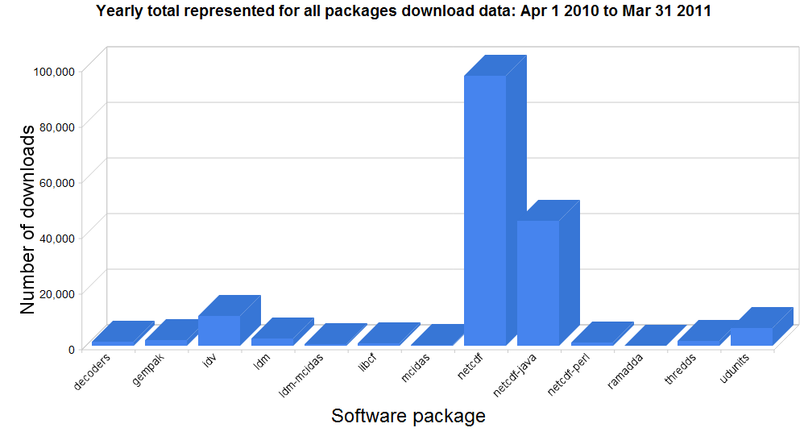
Software Download Metrics
97012
44795
10857
6289
2100
2517
1794

Slide 28
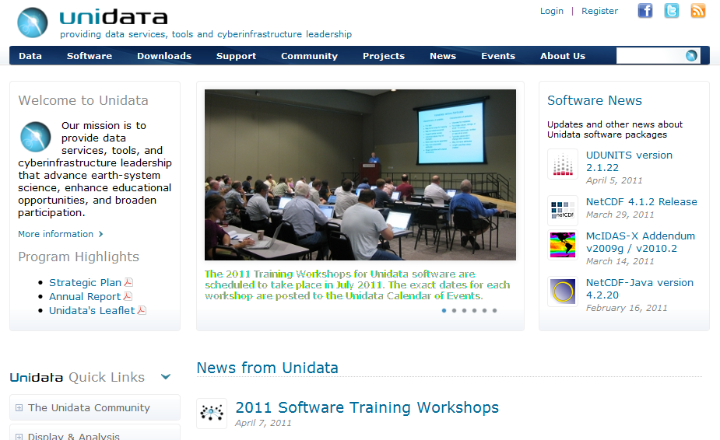
Unidata’s New Website

Slide 29
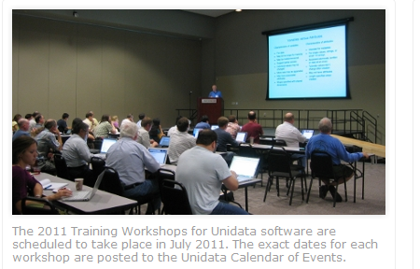
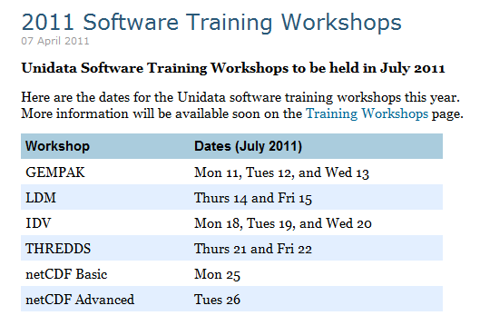
2011Training Workshops

Slide 30
Community Equipment Awards
Over the past nine years, Unidata has made 61equipment awards and given about $1M to various universities.
This year special consideration was given to proposals that:
  Plan to share their data by installing THREDDS and RAMADDA servers.
  Install, test , and provide feedback on prototype AWIPS II servers.
We received nine proposals this year. Eight were funded.
  New Mexico State University
  Penn State University
  Rutgers University
  San Jose State University
  Texas A&M
  University of Colorado/CIRES
  University of Salento, Italy
  University of South Florida
Notes:
The university community has significantly benefited from these grants. Last year, eight awards were made and the success rate was quite high.

Slide 31
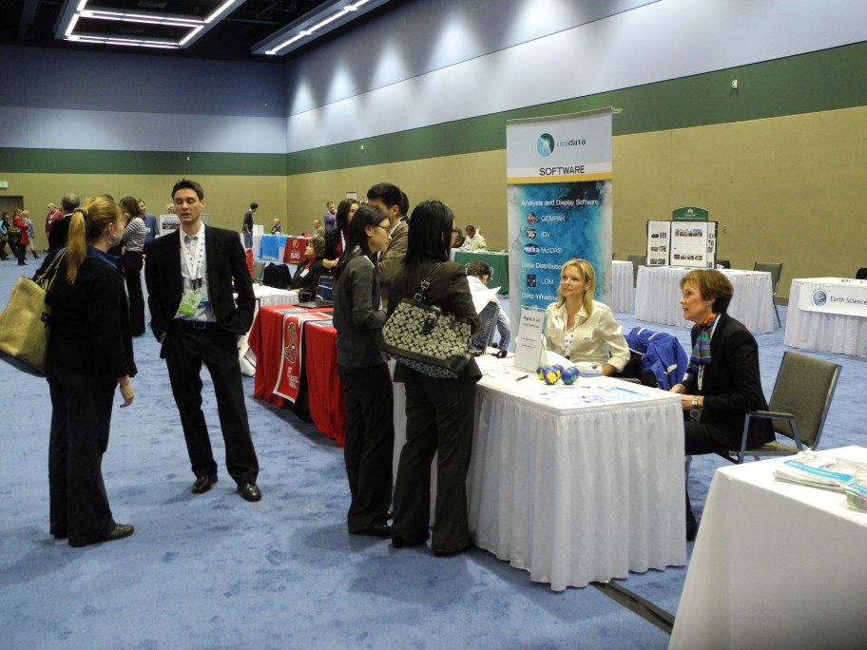
AMS Annual Meeting
Unidata staff took part in the Tenth Annual AMS Student Conference and Career Fair, "Communicating Weather and Climate - The Role of a Young Scientist," held in conjunction with the 2011 AMS Annual Meeting.
Unidata Users Committee Student Representative Stefan Cecelski was on hand to discuss Unidata tools, technologies and data services with students at Unidata's table at the Career Fair, as were several UPC staff members.
Student interest was strong, with attendees lining up to discuss Unidata's offerings and opportunities.
Thank you Stefan!
Notes:
Unidata Users' Committee student representative Stefan Cecelski and Unidata staff members Tina Campbell and Linda Miller talk with students at Unidata's table at the AMS Student Conference career fair

Slide 32
Proposal Activity
Received word that the Integrated Arctic Data Services proposal, a follow-on to CADIS, will be funded by NSF-OPP for a 4-year period. Final negotiations are currently underway.
Submitted another proposal, OPeNDAP-Unidata Linked Servers (OPULS), to NOAA. It will focus on:
  Better data-model specifications
  Rigorous conformance
  Demonstrated extensibility
  Common-framework design
Two other proposals (one to NASA and another one to NOAA (solicited)) are in the works.

Slide 33
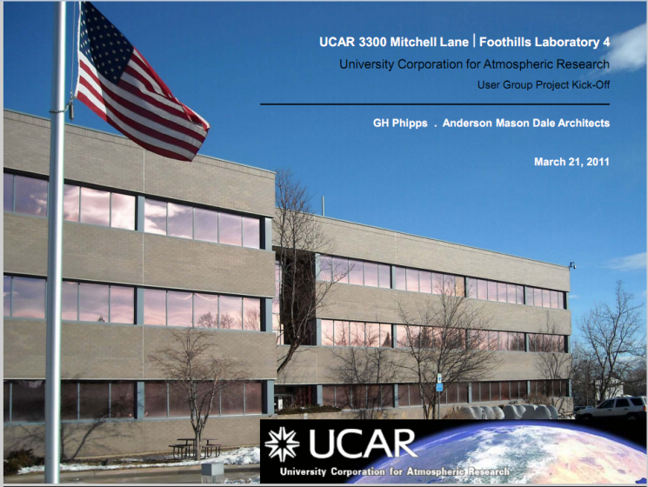
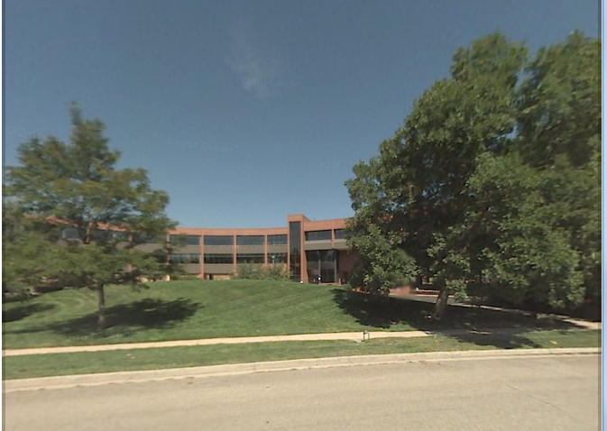
FL-4 Remodel
Remodel Schedule
  10-15 August 2011 - Move to Anthes Building
  21 April 2012 Return to FL4
Project Priorities
1. Building Performance
- Improved heating + AC
- Sustainable energy strategies (LEED Gold Certification targeted)
- Improved access to daylight
2. Building Program / Shared Use
- High end conference facility
- Improved restrooms
3. Department Program
- Collaboration Spaces for users

Slide 34
State of the Program: A Snapshot
Community relations : Green
Data flows : Green
Software development : Yellow
Collaborations : Green
Staffing : Yellow (Soon Green?)
Support : Green/Yellow
Finances : Green
Questions?

