Slide 1


Geosciences Directorate Overview
May 23, 2011

Slide 2
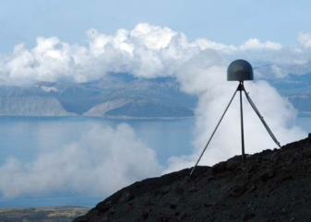
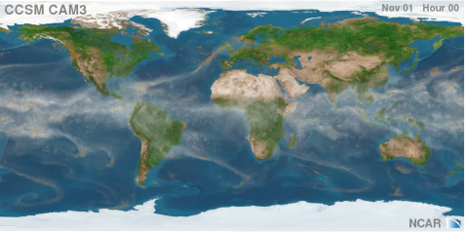
Directorate for Geosciences
Mission
Support research in atmospheric, earth and ocean sciences
Address nation’s need to understand, predict and respond to environmental events and changes
Modes of Support
Unsolicited proposals from all scientists with interests in the geosciences
Special competitions, often interdisciplinary
Promote collaborations with scientists in other disciplines, agencies, and nations
Promote integration of research and education
Long Term support for shared resources, including:
  observational platforms
  analytic facilities
  computational facilities

Slide 3

GEO Vision
A Strategic Plan for the Geosciences
Fostering a sustainable future through better understanding of our complex and changing planet.
  Understanding complex Earth system
  Reducing vulnerability and sustaining life
  Growing geoscience workforce of the future
Key Research Areas to achieve the Geo Vision
  Dynamic Earth
  Changing Climate
  Earth and Life
  Geosphere-Biosphere Connections
  Water: Changing Perspectives
Guiding Principles
  An interdisciplinary approach
  A commitment to research
  Education and public understanding of the geosciences

Slide 4
Budget Request by Division

Slide 5
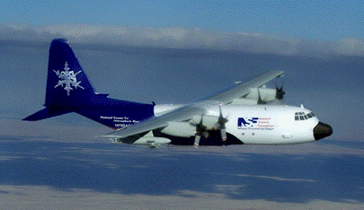
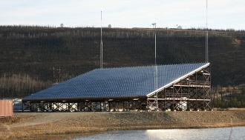
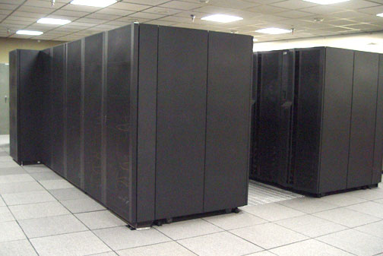
Division of Atmospheric and Geospace Sciences (AGS)
Furthers understanding of weather, climate and the solar-terrestrial system by expanding the fundamental knowledge of the composition and dynamics of the Earth’s atmosphere and geospace environment
Supports large, complex facilities required for research in the atmospheric and solar-terrestrial sciences

Slide 6
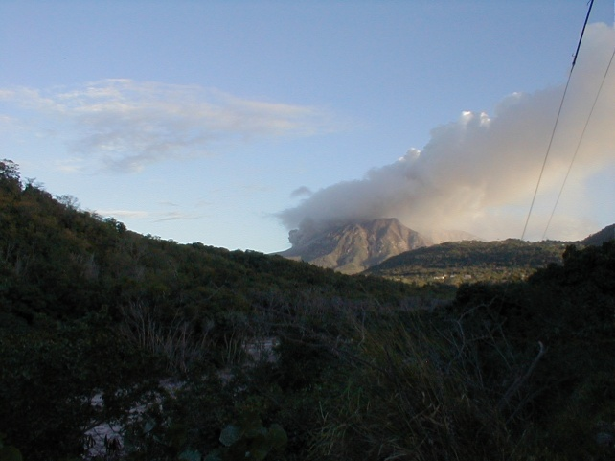
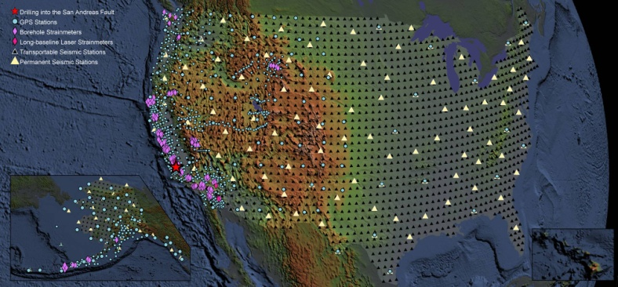
Division of Earth Sciences (EAR)
Improves the understanding of the structure, composition, and evolution of the Earth and the processes that govern the formation and behavior of the solid Earth
Supports theoretical, computational, laboratories and field stations and state-of-the-art scientific infrastructure
Response to earthquake in Japan
  Participating in coordinated response through NEHRP
  Receiving inquiries on RAPID support

Slide 7
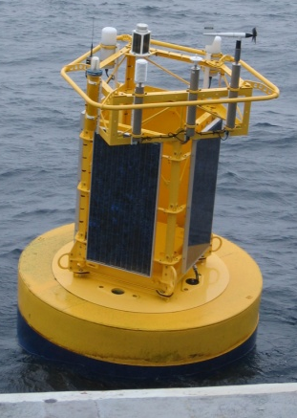
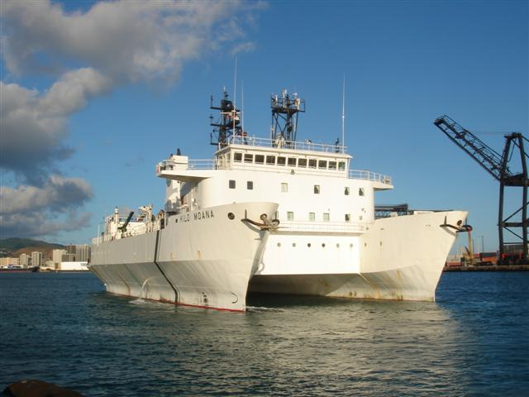
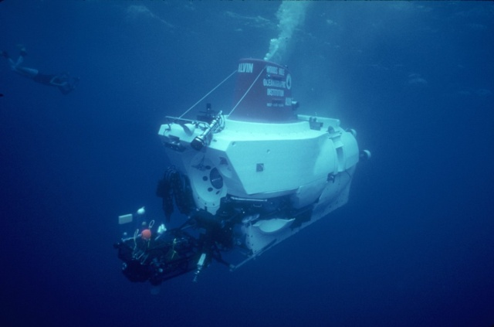
Division of Ocean Sciences (OCE)
Enhances understanding of all aspects of the global oceans and their interactions with the solid earth and the atmosphere
Supports major shared-use oceanographic facilities including research vessels and manned deep diving submersibles

Slide 8
Modes of support
Unsolicited proposals from all scientists with interests in the geosciences
  investigator-initiated collaborative research programs
  individual investigator-initiated research projects
Special competitions, often interdisciplinary
Promote collaborations with scientists in other disciplines, funding agencies, and nations
Promote integration of research and education
Long Term support for shared resources, including:
  observational platforms
  analytic facilities
  computational facilities

Slide 9
FY 2012 Request
In 2012, GEO is requesting $979,160,000
GEO’s FY2012 Budget Request provides exciting opportunities to:
  Carry out basic fundamental geoscience research
  Attack complex multidisciplinary challenges
  Ignite innovation and opportunity for discovery
  Catalyze breakthroughs across the sciences
  Create new networks and cyberinfrastructure
  Explore the planet in new and transformative ways

Slide 10
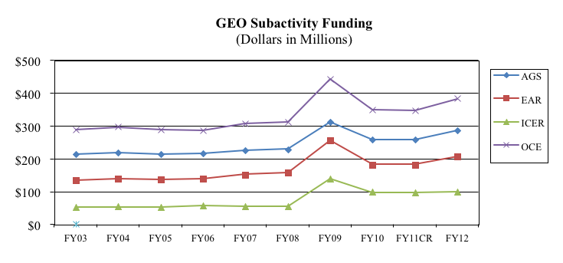
GEO Ten-year Funding History
Flat funding for five years

Slide 11
Major Investments in 2012
Continuing investments in Basic Research, Education & Diversity
World class research infrastructure
Science, Engineering and Education for Sustainability (SEES)
Cyberinfrastructure Framework for 21st Century Science and Engineering (CIF21)
Creating a More Disaster Resilient America (CaMRA)

Slide 12
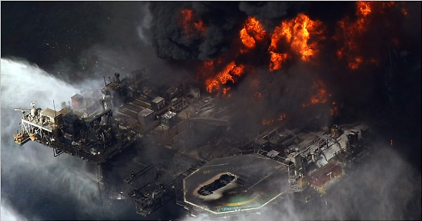
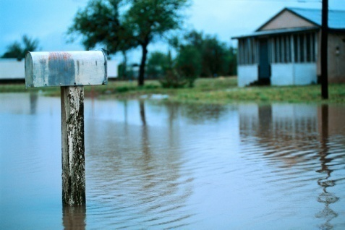

Creating a More Disaster Resilient America (CaMRA)
New, $10M GEO-wide program
Catalyze basic research efforts in hazard-related science to improve forecasting and prediction of natural and man-made hazardous events
Expand scope of activities beyond traditional boundaries.
May foster new partnerships with other agencies.
Responds to AC/GEO and NSTC/CENRS recommendations.
A formal solicitation is planned

Slide 13
Science, Engineering, and Education for Sustainability (SEES)
Goal: Generate discoveries and build capacity to achieve an environmentally and economically sustainable future
FY 2012 priorities:
  Advance a clean energy future
  Nurture the emerging SEES workforce
  Expand research, education, and knowledge dissemination
  Engage with global partners
Environment, energy, and economy nexus
Increase of $338 million over FY 2010 enacted level (GEO increase $87.2M)
Notes:
How do we meet the goal?
The NSF-wide SEES Portfolio is expected to include:
short and long term observations enabled by a new generation of experimental and observational networks;
data analysis, modeling, simulation and intelligent decision-making facilitated by advanced computation;
research at the energy-environment-society nexus;
innovative strategies for energy production, distribution and use;
study of societal factors such as vulnerability and resilience, and sensitivity to regional change;
building of research and education partnerships, both nationally and internationally; and
developing the workforce required for future economic, energy and environmental sustainability.
SEES is planned to be a 5-year effort during which NSF works across directorates and offices to coordinate and grow its portfolio of research and education associated with the environment, energy, and sustainability. NSF’s work under SEES will be a blend of activities -- formal solicitations and less formal announcements of interest (e.g., Dear Colleague Letters) that span multiple scientific disciplines and require input and oversight from multiple NSF directorates.
FY 2012 Priorities:
Clean energy: Through the Sustainable Energy Pathways (SEP) program, NSF will identify energy sources, their potential for future use, and potential impacts of such use on the environment and society
Workforce: new Postdoctoral Fellowship program; will require interdisciplinary experiences, and work with state and local resource managers or staff in environmental or energy sectors
Sustainability Research Networks (SRN) program will form intellectual partnerships across disciplines on important sustainability research topics and encourage academic and other organizations to work on these problems together (public-private partnerships)
Partnerships for International Research and Education (PIRE) program will formalize international collaborations
How current efforts relate to previous activities:
In FY 2010, NSF expanded the base SEES portfolio by focusing on climate; NSF is now integrating energy concerns into the SEES portfolio to address sustainability in a more comprehensive and targeted way. In FY 2012 the next round of CRI solicitations, initially issued in FY 2010, are expected to be issued: Water Sustainability and Climate; Ocean Acidification; Dimensions of Biodiversity; Earth System Modeling at Regional and Decadal Scales, and; Climate Change Education Program.
SEES portfolio management structure
Senior leadership committee composed of Assistant Directors/Office Heads provides long-term planning and overall guidance.
Working groups of program directors, each overseen by Assistant Directors/Office Heads/Division Directors who are most relevant to the specific activity, manage specific programs or activities.
Interagency working groups coordinate interagency activities, which may require establishment of MOUs/MOAs, and joint solicitations between the collaborating agencies.
Engagement and collaboration with international partners, such as the European Union (EU).
SEES Portfolio Funding Levels (Dollars in Millions)
FY10 Enacted/Annualized FY11 CR FY12 Request
Biological Sciences $121.00 $146.00
Computer and Information Science and Engineering $17.00 $46.36
Engineering $108.20 $162.00
Geosciences $195.50 $282.70
Mathematical and Physical Sciences $87.00 $160.50
Social, Behavioral and Economic Sciences $20.78 $56.98
Office of Cyberinfrastructure $5.50 $5.00
Office of International Science and Engineering $2.50 $17.00
Office of Polar Programs $65.26 $83.65
Office of Integrative Activities $26.50 $26.50
Total, R&RA $649.24 $986.69
Education and Human Resources $11.50 $12.00
Total, NSF $660.74 $998.69
* Totals may not add due to rounding

Slide 14
SEES – Geosciences Foci
Sustainable Energy Pathways
  characterize and understand existing energy systems and their limitations (e.g. wind, geothermal, hydro)
  understand risks and stressors associated with new and emerging energy sources (e.g. tidal, clean coal, carbon sequestration)
Sustainability Research Networks
  interdisciplinary research and education partnerships involving government, academe, and the private sector
  address fundamental issues of use in improving policy and practices with regard to energy, the environment, and human well-being

Slide 15

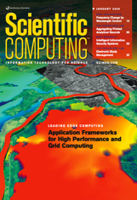
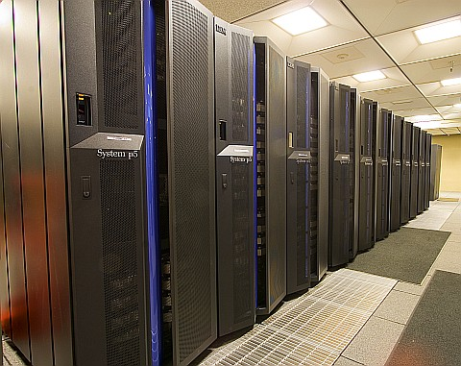
Cyberinfrastructure Framework for 21st Century Science and Engineering (CIF21)
Comprehensive, integrated cyberinfrastructure to transform research, innovation and education
Focus on computational and data-intensive science to address complex problems
Four major components
  Data-enabled science
  New computational infrastructure
  Community research networks
  Access and connections to cyberinfrastructure facilities
Geosciences CIF21 investment is $16M. Interests include:
  acquisition and use of cyberinfrastructure for the conduct of geoscience research
  geoinformatics – the tools and techniques that facilitate data-enabled geoscience
  enhancement of access and connections to facilities and scientific instruments

Slide 16


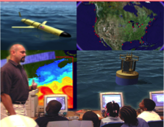

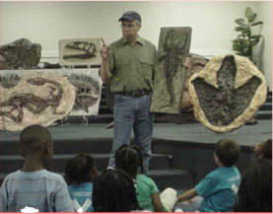
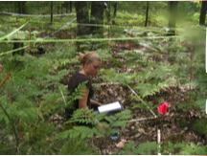
Investments in Education and Diversity
GEO is continuing to develop the geoscience workforce of the future
  OEDG
  GEO Ed
  GEO Teach
  COSEE
  CAREER

Slide 17
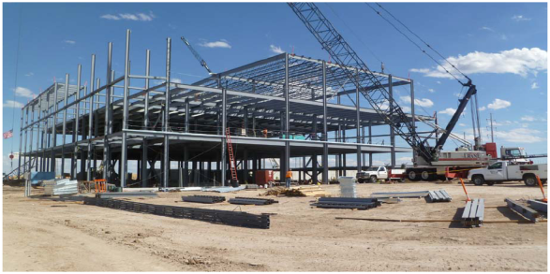
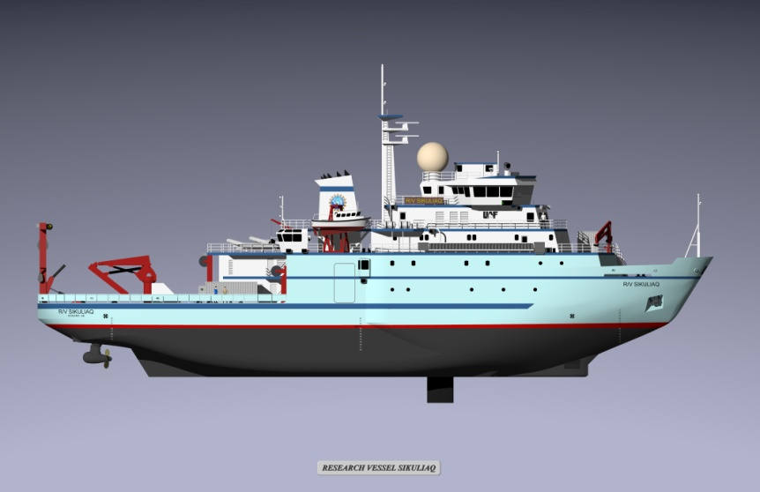
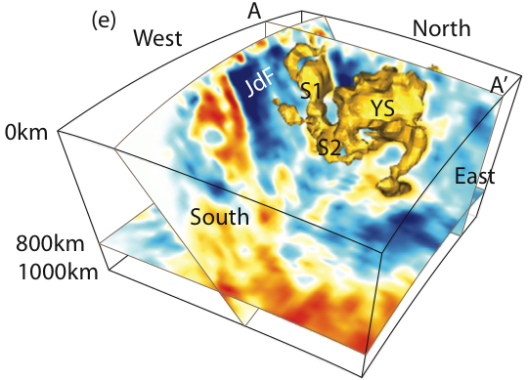
GEO Infrastructure Investments:
Recent, Underway, and Considered
Earth structure in Pacific NW
(Allen et al., 2009)

Slide 18
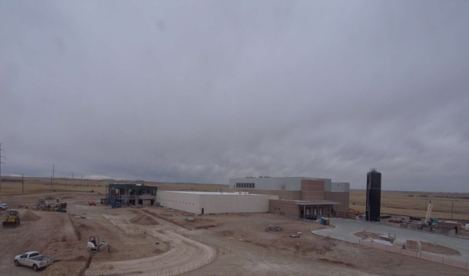
NCAR-Wyoming Supercomputing Center
Construction began June 2010 and proceeding on schedule
RFPs for supercomputer, data storage and data archive drafted.
System will be 1-1.5 Pflops peak – at or above NSF “Track 2”
Earned Value Management System data indicate satisfactory cost and schedule performance in each of the primary areas of activity.
No significant issues or areas of concern.
NWSC Webcam, 03-25-11
MILESTONE | DATE
Completion of Construction | August 2011
Supercomputer and Data Storage Procurement | RFPs: December 2010 HPC Delivery: January 2012
Transition from Boulder | Begins: August 2011
Start of Full Operations | July 2012 (or earlier)
NSF Funding for Construction
2010 | 2011 | Total
$31 million | $17.1 million | $48.1 million

Slide 19
Questions!

