Slide 1
CUAHSI – Unidata Collaboration Opportunities
David Tarboton
CUAHSI
HIS
Sharing hydrologic data
http://his.cuahsi.org/
Support
EAR 0622374

Slide 2
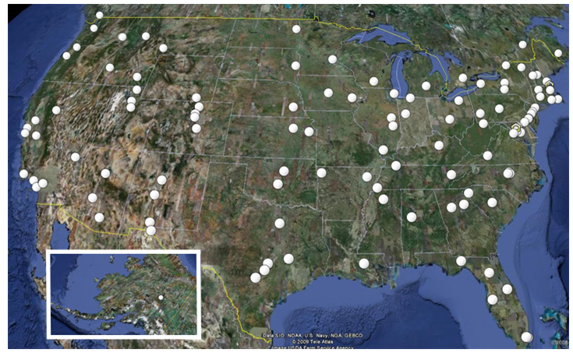
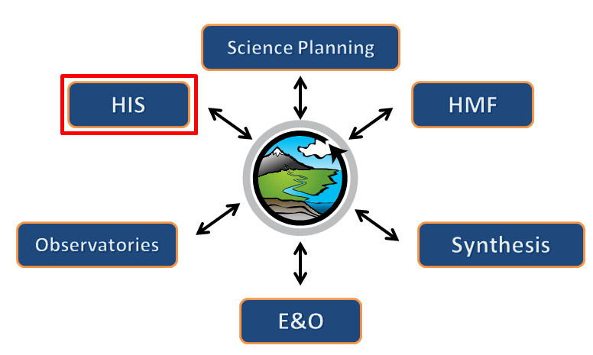
What is CUAHSI?
Consortium of Universities for the Advancement of Hydrologic Science, Inc.
112 US University members
7 affiliate members
16 International affiliate members
(as of May 2011)
Infrastructure and services for the advancement of hydrologic science and education in the U.S.
Support
EAR 0753521
http://www.cuahsi.org/

Slide 3
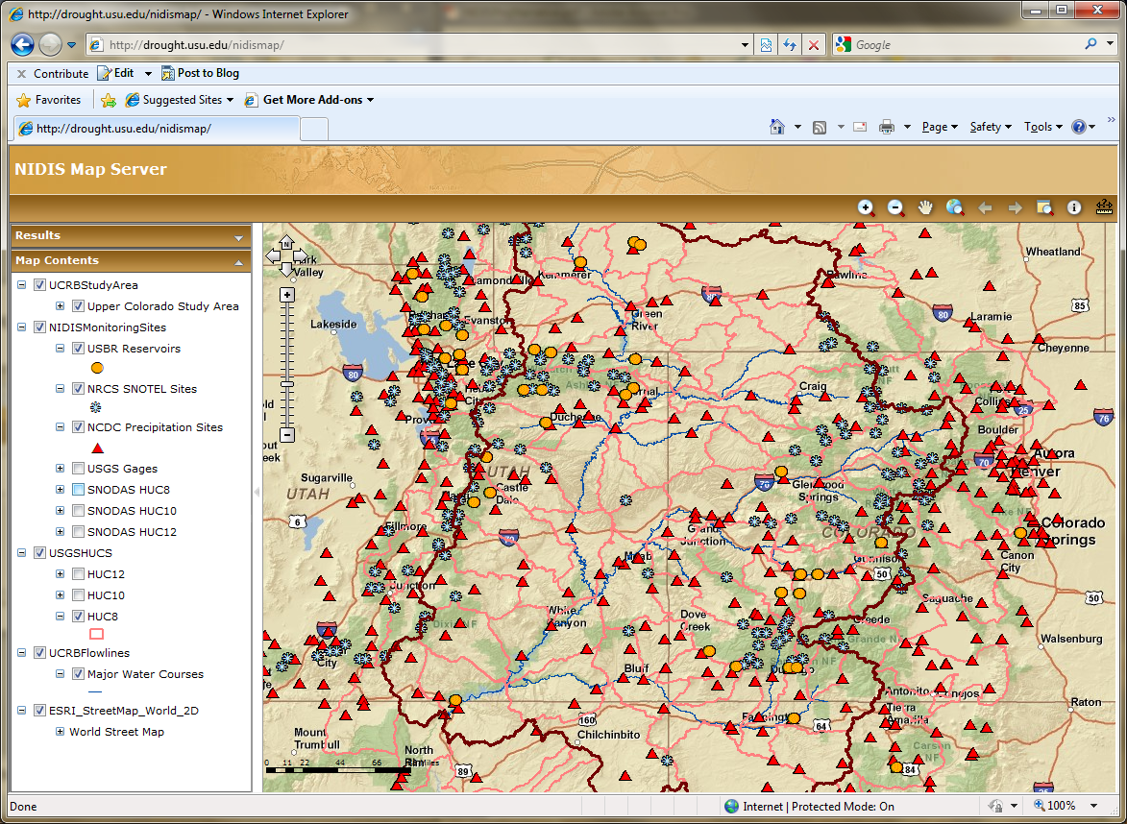
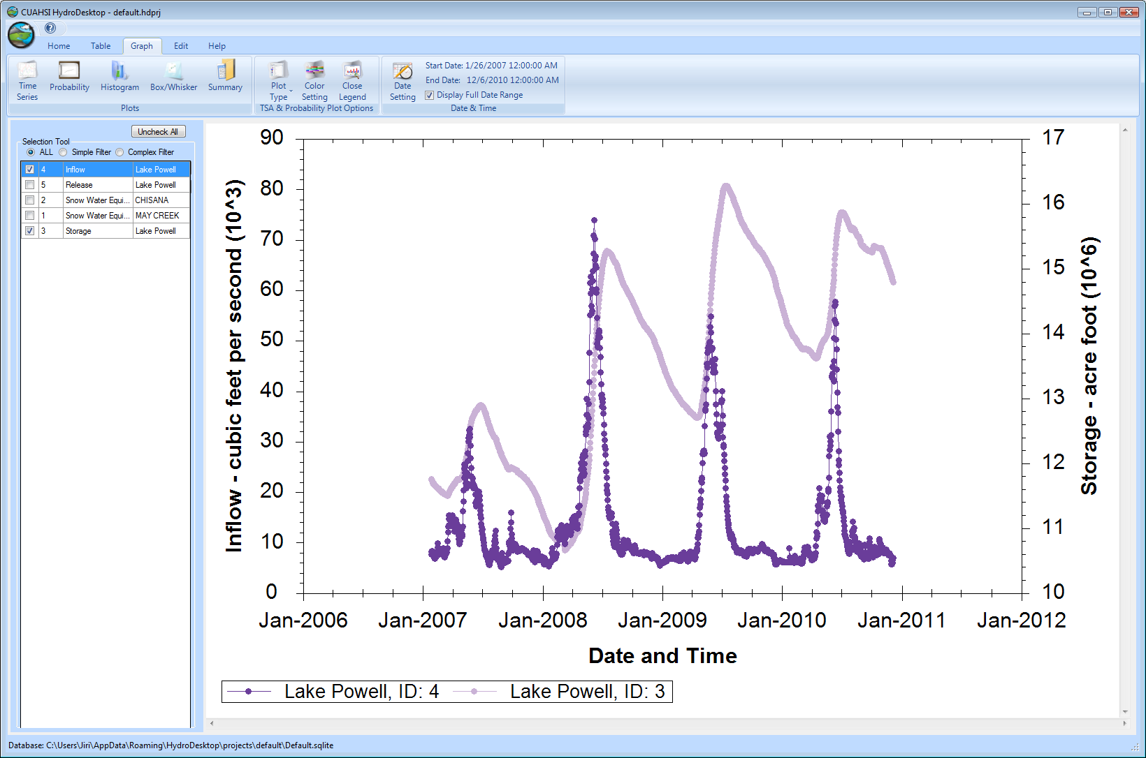
CUAHSI HIS
The CUAHSI Hydrologic Information System (HIS) is an internet based system to support the sharing of hydrologic data. It is comprised of hydrologic databases and servers connected through web services as well as software for data publication, discovery and access.
CUAHSI HydroServer – Data Publication
Lake Powell Inflow and Storage
CUAHSI HydroDesktop – Data Access and Analysis

Slide 4
HIS Team and Collaborators
University of Texas at Austin – David Maidment (PI), Tim Whiteaker, James Seppi, Fernando Salas, Jingqi Dong, Harish Sangireddy
San Diego Supercomputer Center – Ilya Zaslavsky, David Valentine, Tom Whitenack, Matt Rodriguez
Utah State University – David Tarboton, Jeff Horsburgh, Kim Schreuders, Stephanie Reeder, Edward Wai Tsui, Ravichand Vegiraju, Ketan Patil
University of South Carolina – Jon Goodall, Tony Castronova
Idaho State University – Dan Ames, Ted Dunsford, Jiri Kadlec
CUAHSI Program Office – Rick Hooper, Yoori Choi, Conrad Matiuk
Drexel University/CUNY – Michael Piasecki
ESRI – Dean Djokic, Zichuan Ye
USGS – Catherine Lins, David Briar, Scott McFarlane, Nate Booth
NCDC – Rich Baldwin

Slide 5
HIS Goals
Data Access – providing better access to a large volume of high quality hydrologic data;
Hydrologic Observatories – storing and synthesizing hydrologic data for a region;
Hydrologic Science – providing a stronger hydrologic information infrastructure;
Hydrologic Education – bringing more hydrologic data into the classroom.

Slide 6
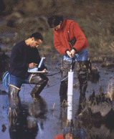
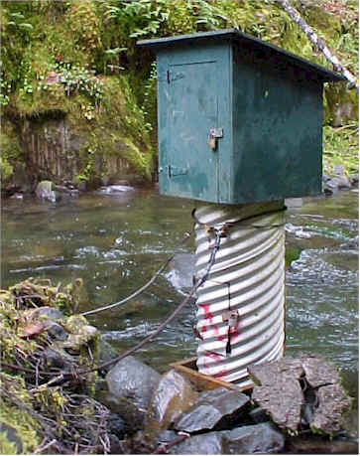
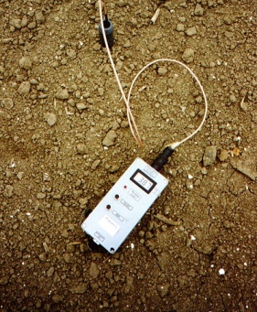
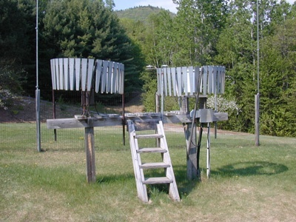
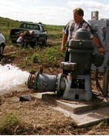
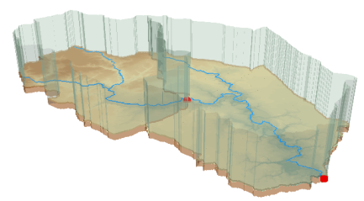
Hydrologic Data Challenges
Water quality
Water quantity
From dispersed federal agencies
From investigators collected for different purposes
Different formats
Points
Lines
Polygons
Fields
Meteorology comparison
Real time assimilation less imperative
Long Records
Rainfall and Meteorology
Soil water
Groundwater
GIS

Slide 7
General Approach Web Paradigm
Catalog (Google)
Catalog harvest
Search
Web Server
(CNN.com)
Access
Browser
(Firefox)

Slide 8
CUAHSI Hydrologic Information System Services-Oriented Architecture
Data Discovery and Integration
HydroCatalog
Metadata Services
WaterML, Other OGC Standards
Search Services
HydroServer
HydroDesktop
Data Publication
Data Services
Data Analysis and Synthesis
ODM
Geo Data
Information Model and Community Support Infrastructure

Slide 9
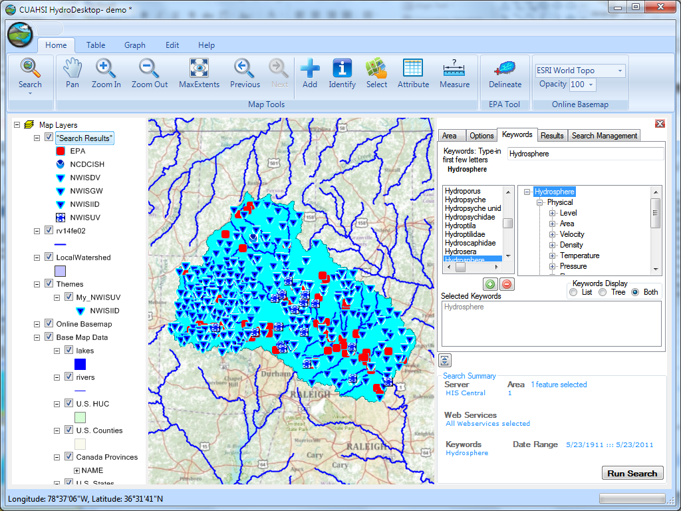
Thematic keyword search
Integration from multiple sources
Search on space and time domain

Slide 10
Unidata Parallels
Data Discovery and Integration
Catalog
?
THREDDS (MotherLode) RAMADDA
?
?
Metadata Services
Search Services
Server
Desktop
Data Publication
Data Services
Data Analysis and Synthesis
OpenDAP
THREDDS
IDV
UDUNITS
NetCDF
Information Model and Community Support Infrastructure

Slide 11
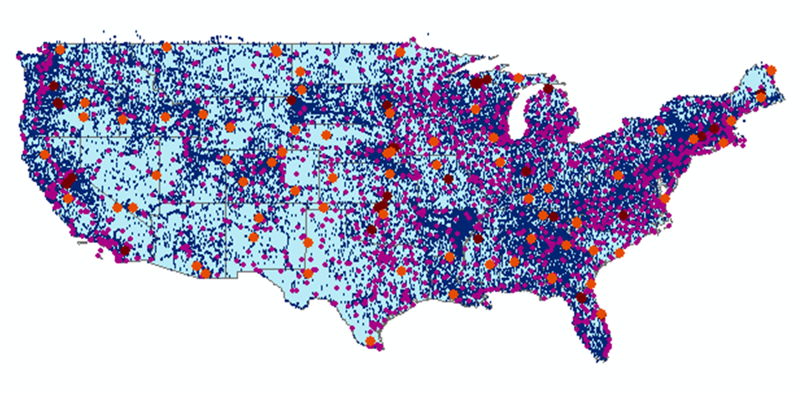
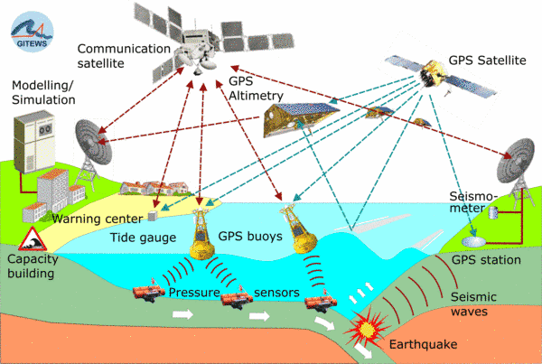
Open Geospatial Consortium Web Service Standards
These standards have been developed over the past 10 years ….
…. by 400 companies and agencies working within the OGC
Map Services
Web Map Service (WMS)
Web Feature Service (WFS)
Web Coverage Service (WCS)
Catalog Services for the Web (CS/W)
Observation Services
Observations and Measurements Model
Sensor Web Enablement (SWE)
Sensor Observation Service (SOS)
OGC Hydrology Domain Working Group evolving WaterML into an International Standard
http://www.opengeospatial.org/projects/groups/waterml2.0swg

Slide 12
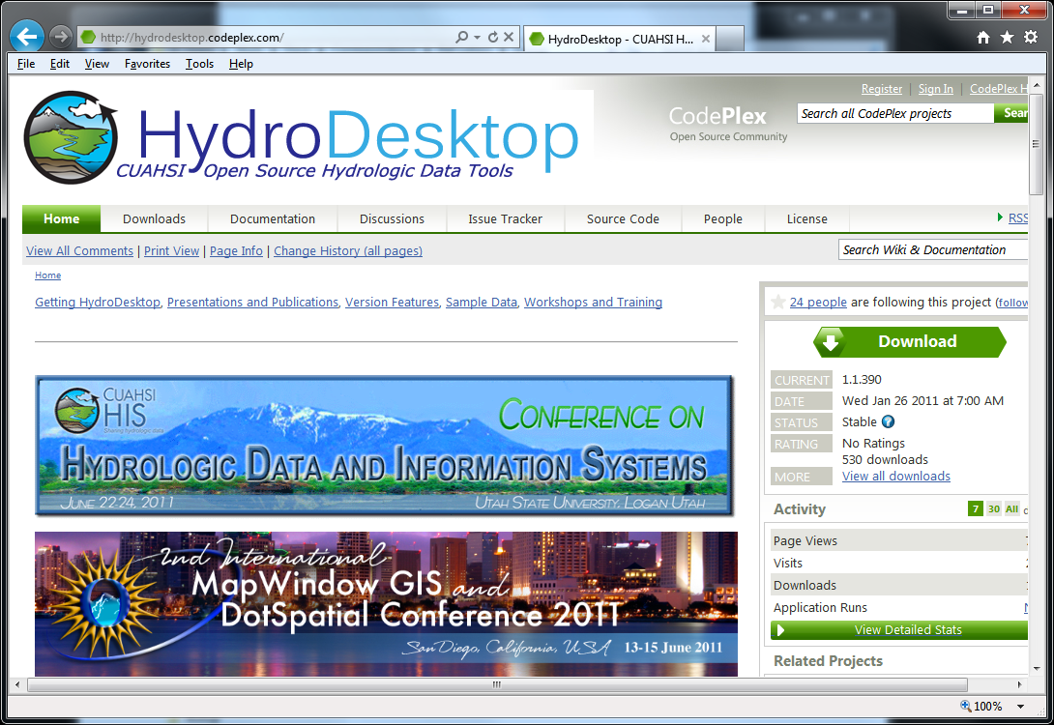
Open Source Development
http://hydrodesktop.codeplex.com
http://hydroserver.codeplex.com
http://hydrocatalog.codeplex.com

Slide 13
Summary
Data Storage in an Observations Data Model (ODM) and publication through HydroServer
Data Access through internet-based Water Data Services using a consistent data language, called WaterML from HydroDesktop
Data Discovery through a National Water Metadata Catalog and thematic keyword search system at HIS Central
Integrated Modeling and Analysis within HydroDesktop
The combination of these capabilities creates a common window on water observations data for the United States unlike any that has existed before.

Slide 14
Architecture
CUAHSI HIS 2.0
Share, Find, Create, Model, Innovate, Transform
Share your work with others
Data Discovery and Integration
HydroCatalog
Standards-based
Semantic and structural mediation over distributed services
New hydrologic information products usable in analysis and modeling
Data integration across environmental disciplines
Compatible services infrastructure for time series, spatial data, geochemical and other formats
Long-term preservation of hydrologic data
Working with libraries, archives and publishers; archivable forms, data curation and provenance management
Extending hydrologic information models to the cloud
Metadata Services
WaterML, Other OGC Standards
Search Services
HydroServer
HydroDesktop
Data Publication
Data Analysis and Synthesis
Data Services

Slide 15
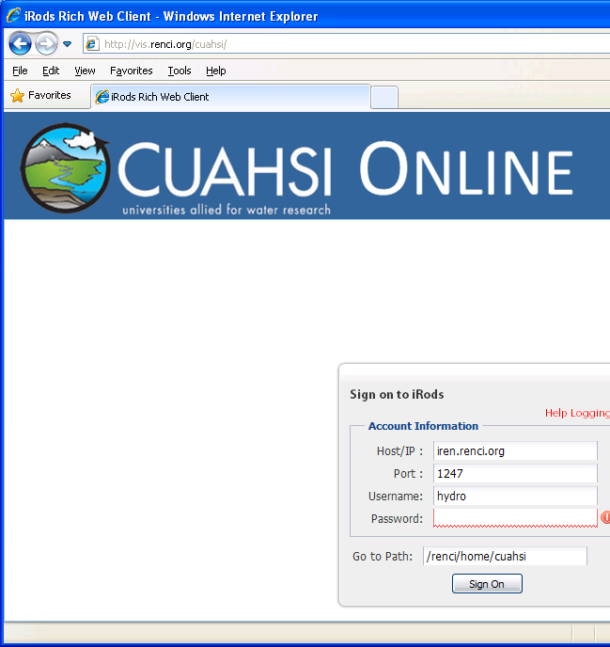
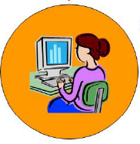
CUAHSI HIS 2.0
Share, Find, Create, Model, Innovate, Transform
Share your work with others
CUAHSI Online Network
A collaborative data and model sharing “social” network for hydrologic science
Simple and easy to use
Find, create, share, connect, integrate, work together online
Archive data collections accompanying research publications in easily accessible way
Integration and synthesis across data collections

Slide 16
CUAHSI Online Data analysis and publication use case
1
6
HydroDesktop
Data Gateway
11
Observer or instrument
5
4
10
Web Services (WaterML)
2
8
7
3
9
HydroServer
HIS Central
Data Storage
Present HIS
CUAHSI Online

Slide 17
Unidata Collaboration Opportunities
NetCDF for gridded data
THREDDS + HydroServer
OpenDAP, WaterML, OGC Web Services
Metadata Catalogs (OGC CSW) for Data Discovery (Ontologies and thematic keyword search)
Interactive Data Social Networking (RAMADDA)
Suggestion for a simple proof of concept exercise to start with
Gridded variable (field) published from THREDDS server wrapped with Metadata to fill required HydroCatalog entries
Discovery, Download and Display in HydroDesktop

Slide 18
Learn about the CUAHSI-HIS System
Share your work with information systems and large scale datasets
Share your use of hydrologic data for teaching
Interact with other users
Share your work linking data and modeling
Show science enabled by HIS
Hands-on workshops
Contribute to the future of HIS
For information on presenting or attending see:
http://his.cuahsi.org/conference2011
Contact: David.Tarboton@usu.edu

Slide 19
Demo if time
Live
Video
http://his.cuahsi.org/
http://his.cuahsi.org/movies/JacobsWellSpring/JacobsWellSpring.html
http://his.cuahsi.org/documents/JacobsWellExercise.pdf

