Slide 1
NAWIPS Migration to AWIPS II Status Update Unidata Policy Committee Meeting
Michelle Mainelli
NCEP Central Operations
23 May 2011

Slide 2
Topics
Project Status / National Status
Activities since October
Forecaster Integration Training
Trouble Ticket Report Status
Data Flow
Training
Unidata Involvement and Benefits
Final Thoughts…
AWIPS II Migration Unidata – May 2011

Slide 3
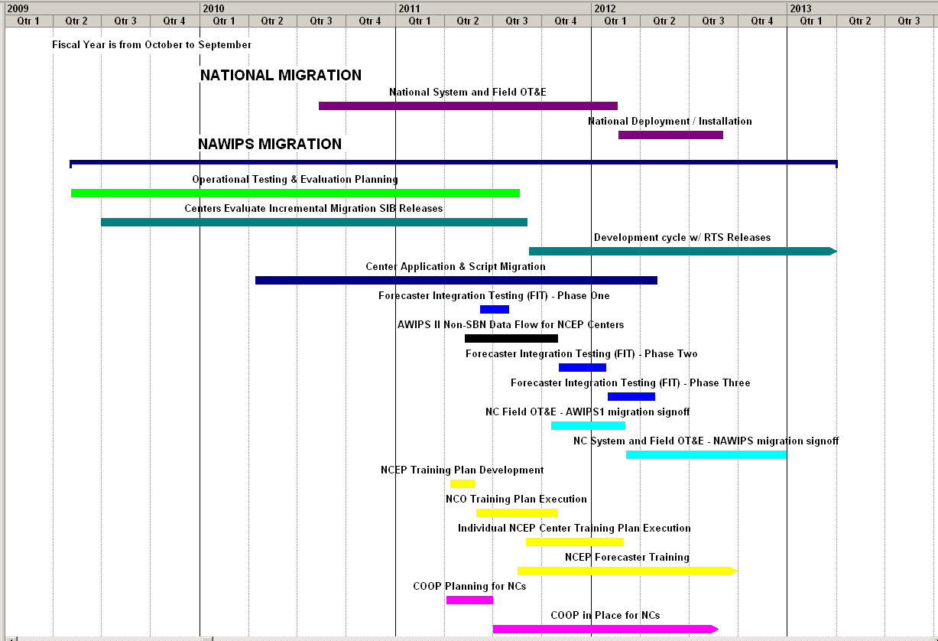
Current Full AWIPS II Migration Schedule
You are here
AWIPS II Migration Unidata – May 2011

Slide 4
AWIPS II Software Release Schedule Update
NWS AWIPS II | Schedule
System OTE | Jan – July 2011
Field OTE including National Centers (4 month duration) | July 18 – November 18 2011
Begin National Deployment (WFOs + NCs) | November 2011
Unidata to Receive AWIPS II | Winter 2011
S/W Release # | Build Release ID | Code Freeze Date | Code Delivery | Test Period
4 | OB11.4 (R2G1) | 3/25/2011 | 4/11/2011 | 4/18/2011 - 4/29/2011
5 | OB11.5 (R2G2) – NCEP Perspective and NCEP Baseline Modules & Decoders | 4/22/2011 | 5/9/2011 | 5/16/2011 - 5/27/2011
6 | OB11.6 – Second update of NCEP Perspective | 5/20/11 | 6/3/2011 | 6/6/2011- 6/17/2011
7 | OB11.7 – Third update of NCEP Perspective – AWIPS II Version prior to Field OT&E | 6/10/11 | 6/20/11 | 6/27/2011 -7/1/2011
AWIPS II Migration Unidata – May 2011

Slide 5
NCEP
PMO-094: AWIPS2 Migration
Project Status as of 19 May 2011
G
Project Information and Highlights
Y
Scheduling
Leads: Michelle Mainelli / David Plummer
Scope:
Migrate current AWIPS I functionality to AWIPS II HW/SW architecture
Migrate current NAWIPS functionality to the AWIPS II HW/SW architecture,
Support the National AWIPS Program by assisting in Discrepancy Reports (DRs)
Completion of migration of local NAWIPS applications to AWIPS II at NCs
Creation of new COOP plans for SPC, AWC, SWPC, and NCO
Removal of AWIPS I at NCEP / Complete Removal of N-AWIPS at NCEP
Expected Benefits:
NCEP integration into NWS AWIPS environment, / Improve NWS collaboration
NCEP better positioned for future software and technological upgrades.
Task/Milestone Target ___ Status_
Baseline NCEP perspective submitted to OST 12 January 2011 Completed
User/Admin Documentation First Draft/NCO 18 January 2011 Completed
Accepted NCEP-wide Training Plan 24 February 2011 Completed
NCO Module 1 Overview March 2011 Completed
NCO Module 2 Topology May 2011 Completed
NCO Module 3 NCP July 2011 Planned
COOP Plans for NCs Developed 31 March 2011 Completed
Baseline NC Perspective/Cave released by RTS May 2011 Completed
Robust Non-SBN Data Flow established 1 May 12 May 2011 Delayed
Begin Forecaster Integration Testing Phase 2 1 August 2011 Planned
Begin Forecaster Integration Testing Phase 3 31 October 2011 Planned
HW Installation Completion by RTS
SPC, NHC, AWC, WWB Feb-April Completed
SWPC June 2011 Delayed
Begin National Field OTE 18 July 2011 Planned
Removal of AWIPS I at NCEP Beginning Nov 2011 Planned
Removal of NAWIPS at NCEP Completed by FY12Q4 On Track
Y
Issues/Risks: (* = new)
Issue: Initial HW/Network/AWIPS architecture to support non-SBN data flow does not satisfy NCP performance
Risk: Local script and applications take longer to migrate to AWIPS II
Risk: WWB AWIPS II migration can be impacted due to NCWCP move
Risk: Possible cooling and electrical issues to support AWIPS II at SWPC
Issue: GFE issues during NWSHQ FIT
Risk: Product Generation code not fully resolved
* Risk: AWIPS II equipment move to NCWCP
* Risk: Not having HW/SW at Scott AFB and Offutt AFB to support COOP
Mitigation:
Test other alternatives for a buyable solution, if necessary. Working group has been spun up with RTS and OST members.
Allocate SIB resources to assist in migration
Extend NAWIPS Field OTE to AWIPS II
Delay installation of AWIPS II at SWPC
DRs have been submitted to AWIPS Program/RTS
Working through OST on who has responsibility of the code
* Re-start original task with RTS / coordinate with AWIPS Program on moving the equipment – ensure SOW /Funding is covered.
* Continue to engage OST on plans to move forward
Y
Finances
Associated Costs:
NCO – 6 FTE/14 Contractors, AWC–1.59 FTE, CPC–1.0 FTE, HPC – 2.6FTE , NHC – 0.75 FTE, OPC – 1.0 FTE , SPC – 2.85 FTE, SWPC – 0.2 FTE, SAB – 0.25 FTE
Costs to cover COOP plans have not be allocated/budgeted
Funding Sources: NCO Base, APO, APO transition funds, Each NC Base Funding
Additional Funding Sources: $1M APO Transition funds + $400K APO annual funding + $240-400K NCO Base
Management Attention Required | Potential Management Attention Needed | On Target
v1.0 10/02//06
R
Y
G

Slide 6
NAWIS/AWIPS I to AWIPS II Migration Status – Risks
Issues/Risks
Issue: Initial HW/Network/AWIPS architecture to support non-SBN data flow does not satisfy NCP performance
Risk: Local script and applications take longer to migrate to AWIPS II
Risk: WWB AWIPS II migration can be impacted due to NCWCP move
Risk: Possible cooling and electrical issues to support AWIPS II at SWPC
Issue: GFE issues during NWSHQ FIT
Risk: Product Generation code not fully resolved
* Risk: AWIPS II equipment move to NCWCP
* Risk: Not having HW/SW at Scott AFB and Offutt AFB to support COOP
Mitigation
Test other alternatives for a buyable solution, if necessary. Working group has been spun up with RTS and OST members.
Allocate SIB resources to assist in migration
Extend NAWIPS Field OTE to AWIPS II
Delay installation of AWIPS II at SWPC
DRs have been submitted to AWIPS Program/RTS
Working through OST on who has responsibility of the code
* Re-start original task with RTS / coordinate with AWIPS Program on moving the equipment – ensure SOW /Funding is covered.
* Continue to engage OST on plans to move forward
AWIPS II Migration Unidata – May 2011

Slide 7
NAWIPS/AWIPS II Activities Since October
Over 95% Software Migration Complete
Delivered NCEP Baseline Modules & Decoders to Raytheon
Delivered NSHARP to Raytheon for incorporation in D2D
Delivered National Center Perspective to RTS end of April
Began Forecaster Integration Testing (FIT) in February 2011
Currently the FIT are on hold until robust data flow is established
Establishing automated Data Flow of non-SBN data into AWIPS II
Conducted Monthly Briefings to NCEP Directors and OST Director
GEMPAK Releases – 6.3 January, 6.4 June 1
http://www.nco.ncep.noaa.gov/sib/nawips/
Submitted monthly updates for Unidata Newsletter
AWIPS II Migration Unidata – May 2011

Slide 8
Forecaster Integration Testing Plan
Each Center has created their own testing plan to conduct at either a FIT on NCEP Test Bed or on their own AWIPS II system once installed
Testing plans include the following:
Text Product and Graphical Product Generation
Data display – model, observational data, satellite, radar etc.
Dissemination of products
Exchange of products within NCEP Centers
System Performance
Created a three-tier approach for testing National Center Perspective
First FIT – Forecasters/IT Specialists are invited to NCEP Test Bed to get familiar with AWIPS II – receive overview training of variances – display data – test product creation
Second FIT – Forecasters/IT Specialists are invited to test data display/product creation once automated data flow is set up. Retest fixed DRs and test the performance of the system.
Third FIT – Forecasters/IT Specialists are invited to give a final test of the system including performance
SIB working with OST/NWSTC about their FITs to improve ours
8
AWIPS II Migration Unidata – May 2011

Slide 9
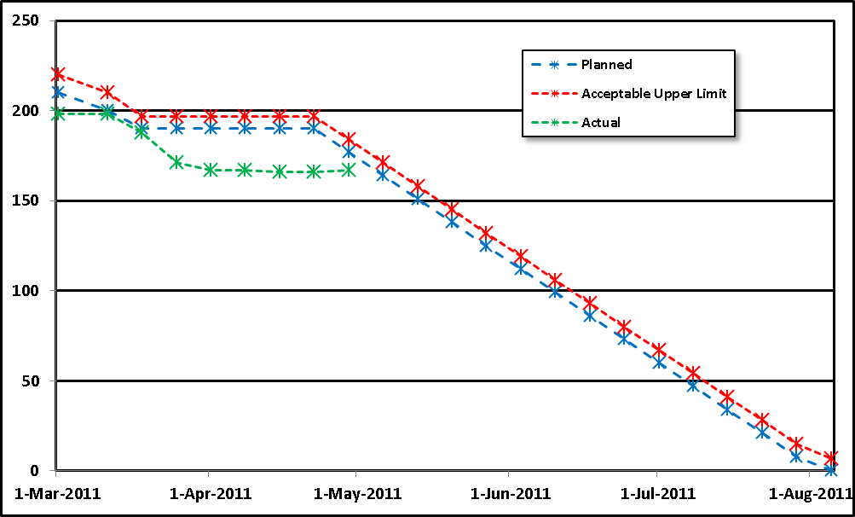
Status of NCEP Trouble Ticket Reports
167 DRs open as of 4/22/11
48 are ready for Retest on NTBN (NCEP Test Bed)
58 Critical, High, or Major
Many DRs are related to data display issues.
No drops,
Limited testing
NCEP drops
To NTBN
AWC FIT
SPC FIT
AWIPS II Migration Unidata – May 2011
Notes:
9

Slide 10
DR Progress Tracking
Open Planned v.s. Actual (05/02/11)
# of Open DR’s
System OT&E
Test Periods
FIT Tests
Actuals as of (05/02/11)
29% rework rate (13 failed DR’s out of 45 tested)
10% wk. ending 04/22, 19% wk. ending 04/15
9 New DR’s last week Avg. 18/wk, last 3 wks
28 DRs wk ending 04/22, 16 DRs wk. ending 04/15
19 net DR increase, (v.s. 44 planned decrease)
3 wk. rolling avg. = xx net decrease per week
2.23 DR’s per person per week, for current wk.
1.41 wk. ending 04/22, 1.72 wk. ending 04/15
Raytheon staff: 39 (unchanged from 6/28/10)
87 DR’s fixed last week. Avg. 70/wk, last 3 wks.
55 wk. ending 04/22, 67 wk. ending 04/15
10

Slide 11
AWIPS II Data Flow for
NCEP Centers
Obtain a robust data ingest method for AWIPS II to migrate and test NAWIPS migrated code. An acceptable method for ingest at all sites is required for both performance and from a security view point.
3 Proposals:
SSH/Rsync: establish a daemon process on AWIPS II that will create an SSH/Rsync connection to a remote site/system for the purpose of synching up a data directory * Approach was tried but proved not to meet NCEP Req
LDM: Establish an LDM process on either the CPSBN Servers for the PX/DX clusters that will contact and establish an LDM connection through the LDAD Firewall w/out requiring data to be dropped onto the LDAD Servers prior to pulling into AWIPS. *Approach will be explored in parallel to below
Direct Connect: Allow access between AWIPS II Systems and the Central Computing System to access large data sets such as GRIB2 model data. *Approach currently being explored.
AWIPS II Migration Unidata – May 2011

Slide 12
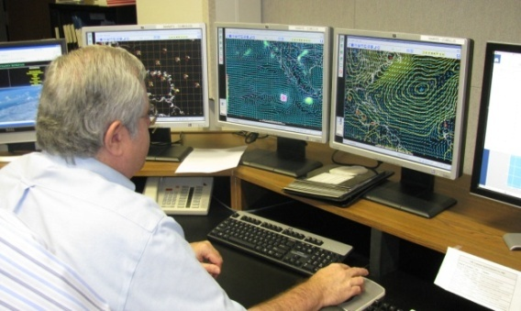
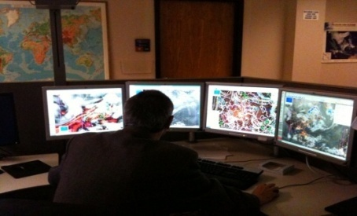
Training Plan
NWSTC will provide sys admin training for AWIPS II ~ FY11Q3
AWIPS II Documentation will be provided by Raytheon
System Overview Presentation (NCP) by NCO – PPT - completed
General System Topology (NCP) by NCO - PPT - completed
NCP/AWIPS II User Interface Introduction – Webinar Early July
Eventually a video of the tutorial will be available (once interface is finalized)
Open the NCO Test Bed for Unidata Community for training purposes – “train the trainers”
AWIPS II Migration Unidata – May 2011

Slide 13
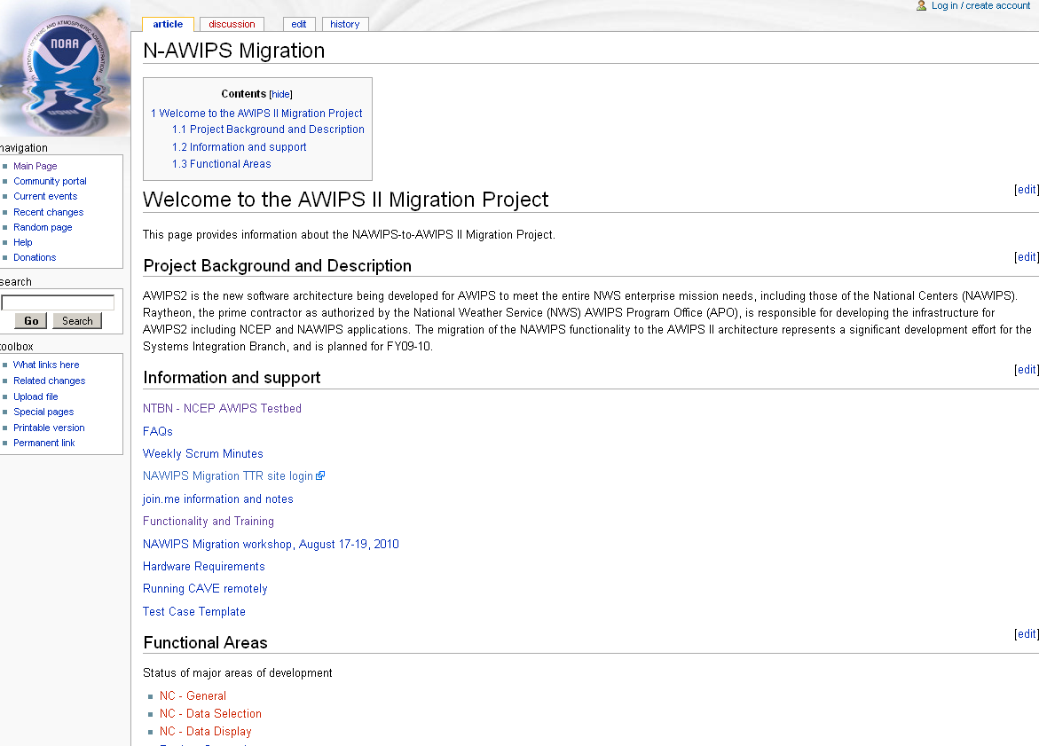
Documentation and Training Materials
Wiki site developed by SIB
Includes weekly status updates of NCEP Test Bed.
Includes minutes and action items from weekly scrum meetings with the Centers
Includes documentation on the variances between NAWIPS and National Center Perspective (NCP)
http://wiki.ncep.noaa.gov/nco/sib/wiki/index.php/Main_Page
AWIPS II Migration Unidata – May 2011

Slide 14
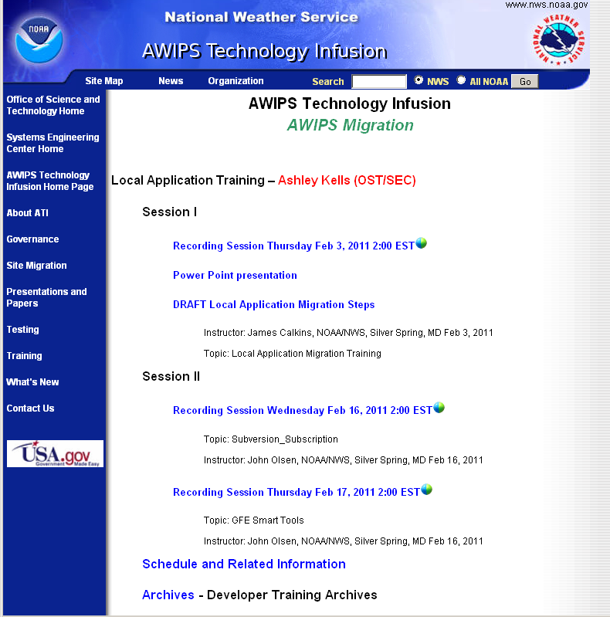
Documentation and Training Materials
Training provided by the AWIPS Program Office.
Provides a good overview of the AWIPS II from a system perspective
Provides overview on how to migrate local apps in AWIPS I environment to AWIPS II.
http://www.nws.noaa.gov/ost/SEC/AE/AWIPSII_LA_Migration_Training.htm
AWIPS II Migration Unidata – May 2011

Slide 15
Unidata Involvement
AWIPS II migration efforts first priority of NWS in FY11 and FY12
Weekly Migration Telecons with Centers and Unidata
SIB is committed to assisting in software configuration and training forecasters and key personnel at Unidata in FY11 and FY12
Unidata has become more actively involved with NWS/OST AWIPS Program
Liaison with the University community
NCEP continues to view Unidata as a critical partner for NCEP’s total mission
AWIPS II Migration Unidata – May 2011

Slide 16
Benefits for Unidata Users
Facilitate Research to Operations
Classroom tool/training
Weather Event Simulator ~ Development 2012 / Delivery 2013
One NWS Operational System
National Field OTE & National Deployment
Less data processing required
Run your own EDEX to create database
Modern development environment/platform
Flexible & expandable architecture
Object oriented languages such as Java and Python
AWIPS II Migration Unidata – May 2011

Slide 17
Final thoughts…
AWIPS National Program Field OTE has slipped around one month and National Deployment slipped from Sep to begin Oct/Nov 2011
Allowed more time for NCO to migrate software into baseline
NCEP transition remains highly dependent on National AWIPS Program Schedule
NCO has encountered a few stumbling blocks over the last six months – HW install/Dataflow/Software integration by Raytheon; however, these blocks have NOT resulted in significant delays in schedule
Strong partnership will remain between NCEP and Unidata through transition and in the years to follow
AWIPS II Migration Unidata – May 2011

Slide 18
Questions ?
Where America’s Climate, Weather, Ocean, and Space Prediction Services Begin”
“From the Sun to the Sea…
Where America’s Climate, Weather, Ocean and Space Weather Services Begin”
AWIPS II Migration Unidata – May 2011

Slide 19
GEMPAK Support and AWIPS II Licensing
GEMPAK will be supported until a full replacement is ready
GUIs deprecated eventually
Unidata support of GEMPAK for 18 months after 1st release ~ Summer 2013
AWIPS Program will deliver code to Unidata in the future
First release expected Winter 2011
Licensing of software
GEMPAK developed by the Federal Government – open software
Once NWS implemented, AWIPS II will have open software policies; however, obtaining the code may need to go through a FOIA request – requests will be expedited from Unidata
Some decoders (such as lightning decoder) and tools to disseminate products will be removed in non-government version
AWIPS II Migration Unidata – May 2011

Slide 20
AWIPS II Hardware Configuration for NCEP
DX – EDEX Cluster (4) DX – Database Cluster (2) PX – Pre-processors (2) LS – LDAD Processors (2)
HP DL 380
Dual Quad Core E5520
8+ GB
2x146 GB 15k SAS – RAID 1
CP - Comms Processor (2)
HP DL 380
Single Quad Core E5520
6 GB
1x146 GB SAS
LX – Workstations (8)*
HP Z800
Quad Core X5550 2.66 GHz
16 GB
1x146 GB 15k SAS
2x nVidia GTS250 1024MB
4x 20-inch widescreen monitors
Infrastructure
Cisco 2960 Switch
Cabling / Firewall / Racks
Novra SBN Ingest
Printers .. Etc
Storage
NetApp FAS3160C
26 TB total disk space using SAS drives
AWIPS II Migration Unidata – May 2011

